Slide 1

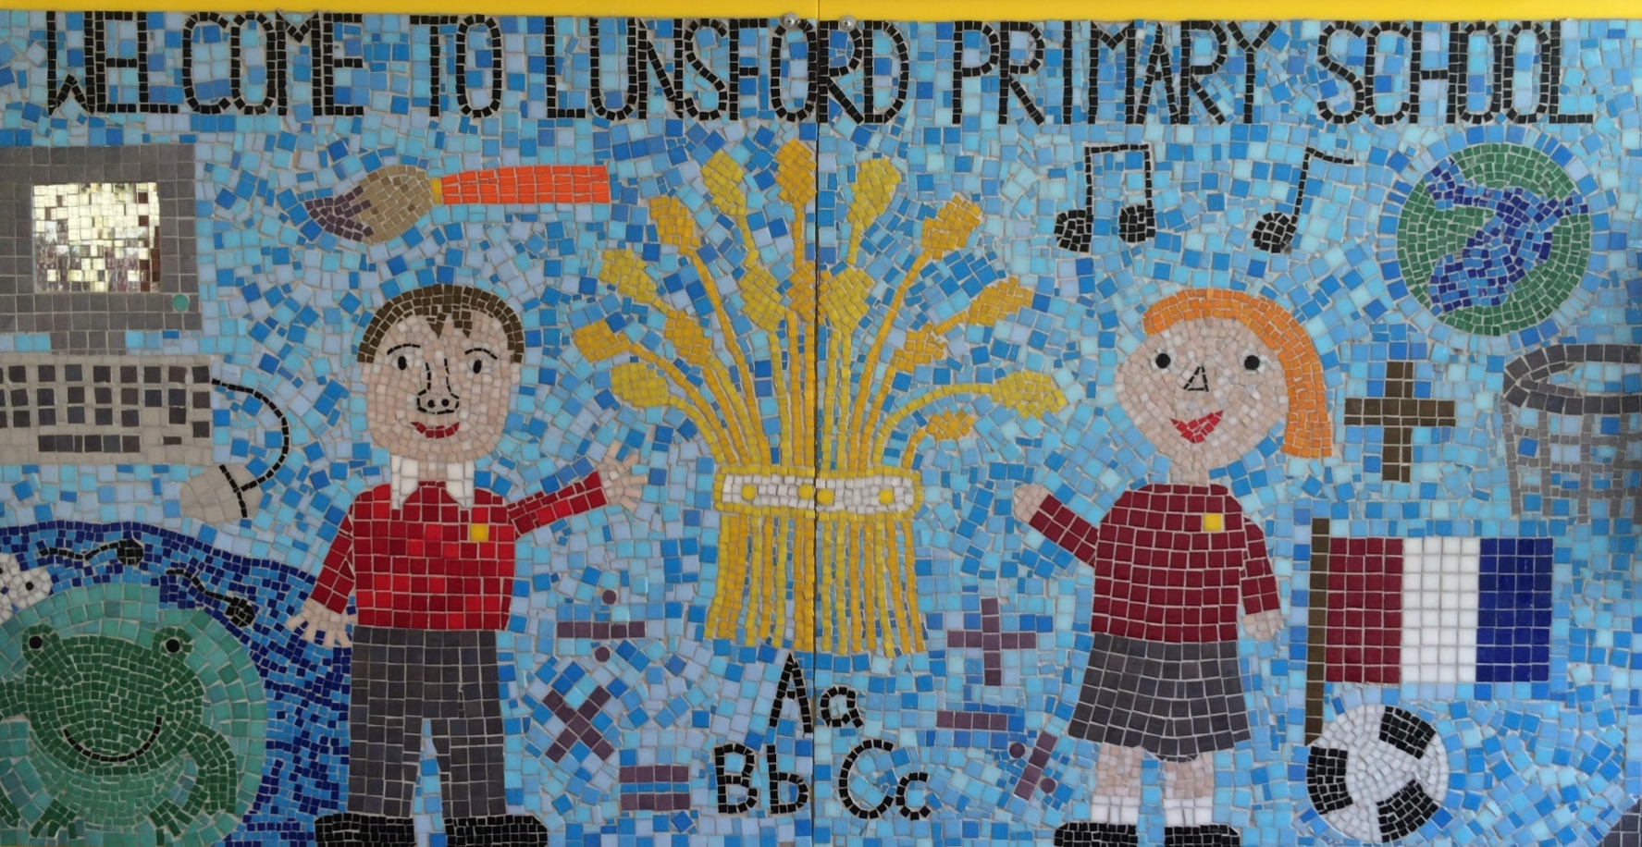
Lunsford Primary School
Welcome to our school!

Slide 2
Who’s Who?
Headteacher – Mr G Anscombe
Deputy Headteacher – Mrs E Lomax
Class Teacher – Miss Graves
Class Teaching Assistants – Mrs Birchard
SENCO – Ms S Beckett ( Tues, Wed, Thurs)
FLO – Mrs A Taylor
Office Manager – Mrs K Mead
Co – Chairs of Governors – Mrs J Sharpe and Mr G Hodnett
FOLS – led by Mrs Friend

Slide 3

Our Values:
Kindness Respect Positivity Perseverance Responsibility Hard work
OUR VALUES
We are KIND
We are RESPECTFUL
We are POSITIVE
We PERSEVERE
We are RESPONSIBLE
We are HARD WORKING

Slide 4
Our School Rules
Be SAFE
Be READY
Be RESPECTFUL

Slide 5
SCHOOL RULES – SAFE, READY, RESPECTFUL.
There are just 3 simple, clear and coherent behaviour expectations.
This makes it easy for adults and children to recognise good behaviours and expectations.
They are easy to follow and easy to remember enabling all children and all adults to embrace them.

Slide 6
BE SAFE
We are SAFE when:
we move around school in a safe manner;
we follow instructions to keep ourselves safe e.g. on school trips;
we use equipment safely;
we stay safe online;
we cross roads safely;
we keep our hands and feet to ourselves…

Slide 7
BE READY
We are READY to learn when:
we arrive at school on time;
we have our equipment ready;
we show that we are listening,
we are ready to start lessons;
ready to listen and follow instructions.

Slide 8
BE RESPECTFUL
We are RESPECTFUL when:
we listen when others speak;
we respect the property of our friends and the school;
we show manners;
we consider others' feelings;
we focus our attention;
we show effort

Slide 9
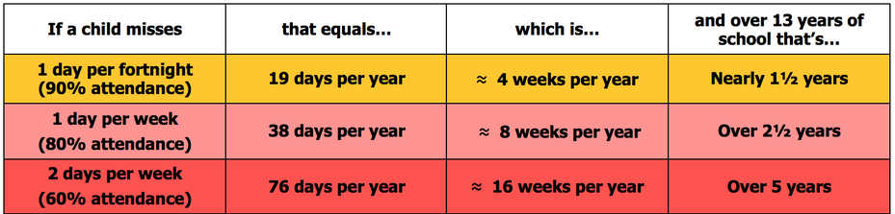
Attendance
Lunsford Primary monitors the attendance of every child in the school. We work with and support those children and their families who are not attending school without sufficient reason. Our attendance target for this academic year is 96.5% attendance.
To put this in perspective 95% sounds good, but means that your child misses:
one half day each fortnight
two weeks every school year
over three-quarters of a school year in a school career
Notes:
GA KM

Slide 10


Attendance
A key factor in a child’s success at school is regular and punctual attendance.
We will reward good attendance
We will be robust in chasing up poor attendance and children who are persistently late
Term-time holidays will not be authorised unless there
are exceptional circumstances
Notes:
GA KM

Slide 11
Uniform
The expectation is that all children will wear the correct school uniform. This includes smart, black shoes.
No such thing as inappropriate weather – only inappropriate clothing!
Sweatshirt, Polo Shirt, Black/grey trousers/skirt, summer dresses – red and white
PE Kit in to be worn on PE days Monday and Wednesday
Labelled please
Order from Brigade online.
We want to foster and develop a real pride in our school from the very beginning
Notes:
GA EL

Slide 12


Slide 13
Our Topics
Elephant Class (Year 1) | Lunsford Primary School

Slide 14
Reading
It is essential that you read with your child at home for 10-15 minutes everyday.
Don’t forget to record minutes read each Wednesday for Buster Book Club.
Children have a reading for pleasure book that they can read for Buster Book Club until the Little Wandle books are sent home next week.
Race to read – we are collating the number of days your child reads at home and tracking them on a race track at school. Please log every time you read – even if a bedtime story that you read to them.
Reading bag – On a Friday I will choose a child to take home our new reading bag/ bear. Inside the bag are: books, a soft toy, a journal to draw a picture in/ write which book was your favourite and a few biscuits to enjoy together.

Slide 15
Homework
From Term 1 the children will be receiving homework.
I will send home a maths sheet in a purple book.This homework will go home on a Thursday to be returned the following Wednesday.
I also expect the children to read daily and would like them to play on Numbots at home weekly.

Slide 16
PE
Mondays with Mr Dickinson
Wednesdays with Miss Graves
Outdoor Games Trainers (which might get muddy), PE t-shirt, shorts, jogging trousers, sun hat for summer, spare socks (for those wearing tights).
Forest School will take place twice a term.
Children to wear PE kit on PE days
Earrings must be taken out and long hair tied back.
Please make sure all items of PE kits and uniform are named.

Slide 17
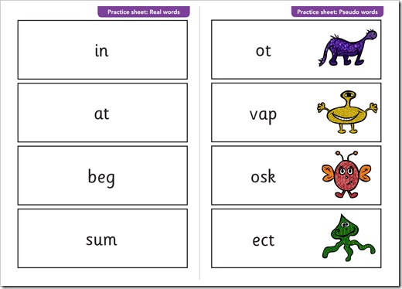
Phonics Screener
Government test taking place in June.
Children will need to read a mixture of real and alien words.
Out of 40

Slide 18
Online Safety
Many Lunsford children regularly use the internet and social media and we have a duty to help them keep safe online.
Users should be sixteen to use WhatsApp and thirteen to use Instagram, Snapchat, Twitter, Facebook, Skype and TikTok.
Although there is no age restriction for watching YouTube videos, users need to be thirteen to have their own YouTube account enabling them to subscribe to channels, like videos, post comments and add videos.

Slide 19
Online Safety
If your child does use social media, please help them to check their privacy settings, disable any chat settings and ensure they know how to block and report.
www.net-aware.org.uk provides lots of up-to-date information for parents.
Please let us know if there any issues regarding the online behaviour of Lunsford children at any time.
We will always follow this up within school in line with our online safety, safeguarding, behaviour and acceptable use policies.
Please see Mrs Lomax if you have any other queries about online safety.

Slide 20
Getting in Contact
At Lunsford, we have an open door policy. We want to work in partnership with parents and carers and strive to achieve the best for all children.
We ask that if you have any worries or questions regarding your child or a problem related to school, please do not hesitate to contact us so we can understand your concerns and help to solve any issues . If we do not know there is a problem, it is very difficult for us to help you or your child.
If you feel that an issue has not been dealt with appropriately, please speak to Mr Anscombe or Mrs Lomax, or we will happily provide you with a copy of the formal complaints procedures.

Slide 21
Getting in Contact
If you would like to speak to a member of staff…
Mrs Mead will forward on any emails and pass on any telephone messages.
Miss Graves can be contacted via Class Dojo. We will try to reply as soon as possible (within 24 hours during the week) but urgent messages should be sent via the office as we will not necessarily be able to access Dojo whilst we are teaching!
A member of the Senior Leadership Team will also be available on the playground every morning and afternoon.
Our Family Liaison Officer (FLO) Amy Taylor can be contacted on 07552 045390.

