Slide 1
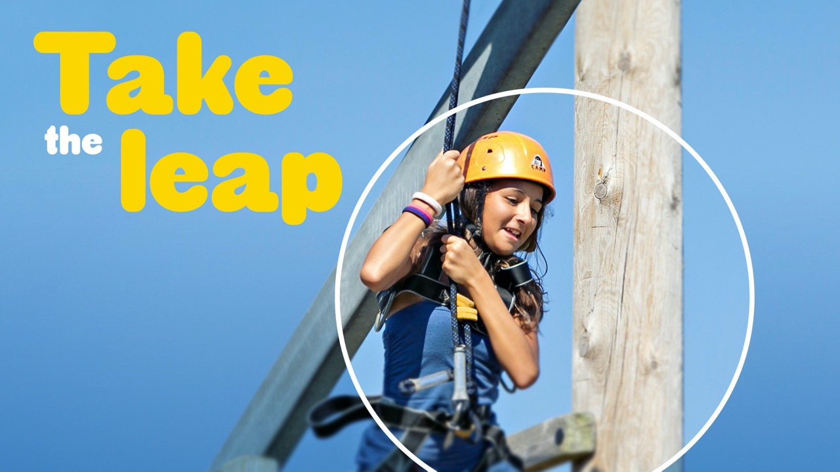

An educational adventure to remember…
Location: Grosvenor Hall, Kent
Date: 18th – 19th March 2024

Slide 2
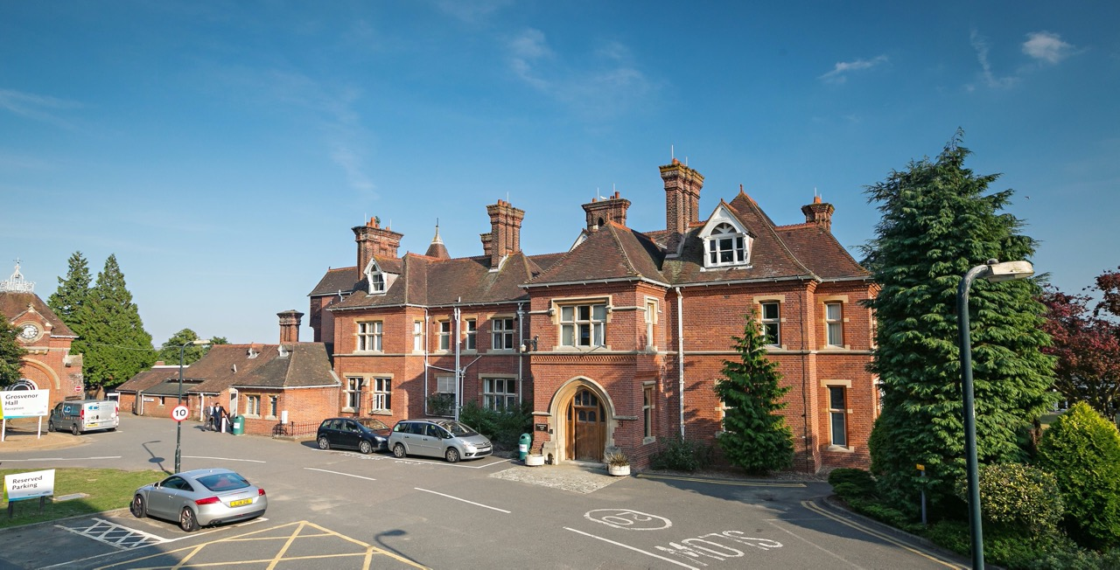
Welcome to
Grosvenor Hall
Kennington, Ashford, TN25 4AJ

Slide 3
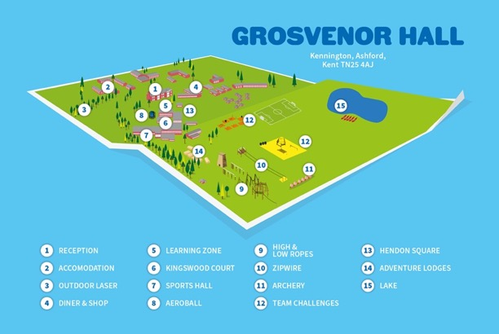
Your centre
A complete indoor and outdoor education facility set in the grounds of a former manor house in Ashford, Kent. One of our largest centres, Grosvenor Hall has 50 acres of adventure and recreational facilities.
As you explore the centre guests continue to discover everything Grosvenor Hall has to offer including a 25,000 sq. ft sports hall which caters for a wide range of indoor activities.

Slide 4
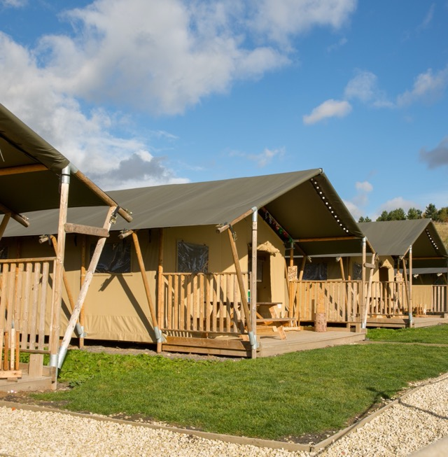
A bit more about your centre…
Sleeping
Grosvenor Hall has standard dormitory style accommodation. Rooms range from 6- to 8-bed rooms, with gender-separated bathroom and shower facilities. There will be 3 members of staff accompanying the children on the trip (Miss Broadmore, Mr Murray and another adult TBC), all staff members will have rooms close by to the children.
Sheets, duvets and pillows are provided for all guests. Children will be asked to make their own beds on arrival, but we will assist them! It definitely helps us if they can practise making a bed at home before the trip!
Children will find out their room allocations on arrival, they will be asked to name friends they would like to share a room with and will be guaranteed at least one of their friends will be with them. This is something that will be completed in school this week.

Slide 5
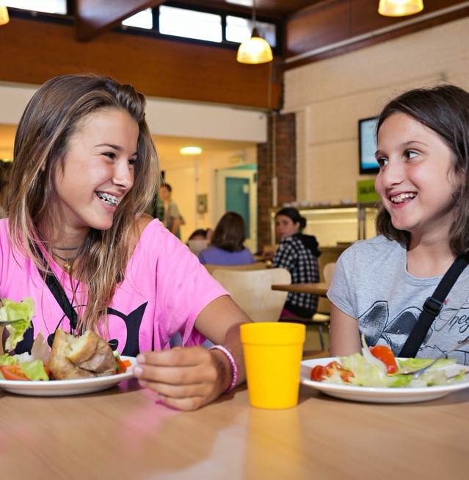
A bit more about your centre…
Eating
The children are provided with an evening meal on the first day and breakfast and lunch on the second day, with lots of choice and seasonal variations. Please ensure your child bring a packed lunch with them on the first day, children who are entitled to free school meals can request a packed lunch from Nourish via the School Office.
Each day there is a carefully balanced and nutritional meal plan, recently updated to meet and exceed the latest Government standards on young people's. Kingswood can cater for most dietary requirements.
If you have any dietary requirements for your children, please could you let me know as soon as possible, so we can make them aware before arrival.

Slide 6
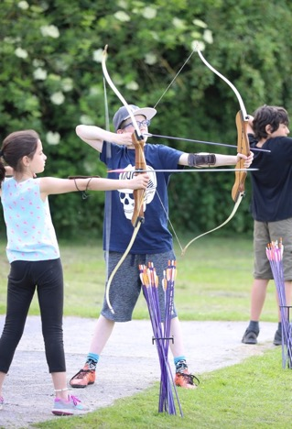
Activities*
Children will be told which activity group they will be in a few days before departure. The programme for the visit will include:
Nightline: The Nightline is essentially a rope which is there to guide you through a series of obstacles. If the rope goes over something then you must go over it, if it goes through something then you go through it and so on. The challenge is that throughout the course you will be blindfolded which will require you to call on your senses other than eyesight and communicate with your team around you.
Campfire on the Monday night
Quick Zip: Participants gather their confidence, determination and adrenaline to step off the platform and go flying down our zipwires. Children will experience the perception of taking risks, but in a controlled environment with helmets, harnesses and fully qualified Instructors.
Archery
Subject to last minute changes

Slide 7
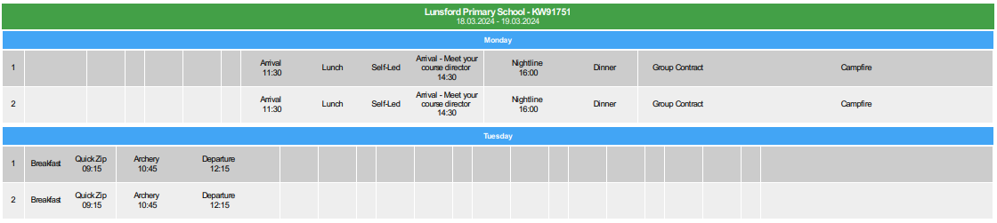

Slide 8
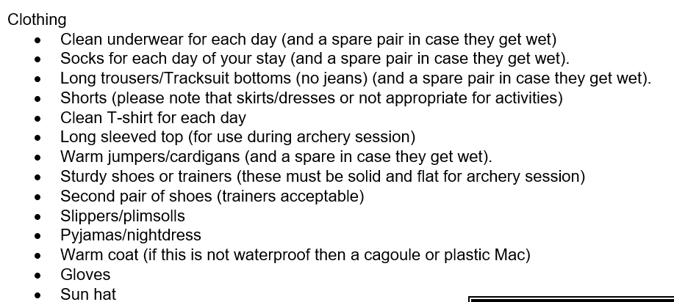
Kit list – a copy will be given to you after the meeting

Slide 9
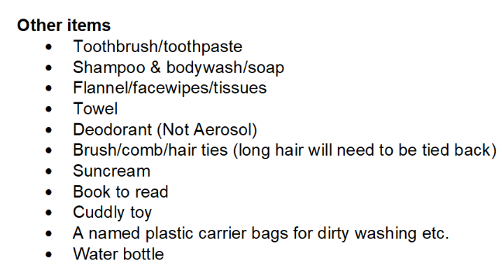

Slide 10
Prohibited items
No aerosols;
No hair dryers or straighteners;
No makeup;
No electronic games;
No mobile phones or smart watches;
No money needed.

Slide 11
The day of departure
The children will need to come into school in non-uniform at normal time on Monday morning.
Please drop their bags into the classroom: the side door will be opened for you.
When packing your child’s bag, please bear in the mind the following:
  Please pack with your child, so they know what item they are taking
  Please do not send them with brand new clothes, as it is more than likely they will get very muddy – particularly in the activity Nightline!
  Please ensure all the item they are taking have their name clearly marked on them
  Please ensure you pack a black plastic bag for any clothes that get wet or muddy
  Please make sure your child can carry their bag, as they will be expected carry it on and off the coach and to their rooms.
As with all activities in school please do not send your child with any earrings or jewellery.
Any medication that has not been handed into the School Office should be passed to the School Office as the children arrive (please note any medication currently held in school will not be accompanying your child, please send the medication they use at home). Please ensure that it is clearly marked with your child’s name and dosage information. Please do not send your child with Calpol as we will be taking a bottle with us, if your child requires a dose, we will ring you first to gain your permission.

Slide 12
The day of departure cont…
The coach is due to depart at 10.45am – 11am approx, if you are intending to wave your child off, please wait at the end of the driveway where the coach will be parked.
Please do not park in Swallow Road near the school gates as this will block the coach’s exit. It is a short drive to Kingswood (approx. 35 minutes), so the children will not need to bring MP3 players or electric games.
The day of return
The coach is due to depart Kingswood around 1.30pm on the Tuesday and will be back before the school day ends (unless traffic causes delays). If there are any delays, we will contact you via our texting service.

Slide 13
In case of emergencies
If you have an emergency and you need to speak to a member of staff at Kingswood, in the first instance please call the School Office on 01732843352. Who will contact the staff for you.
For out of hours emergencies only please call 07726930456.

Slide 14
Any questions???

