Slide 1

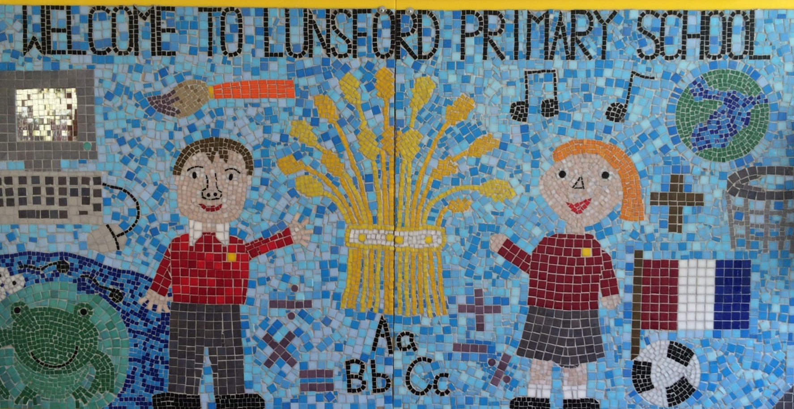
Lunsford Primary School
Welcome to our school!

Slide 2
Who’s Who?
Headteacher – Mr G Anscombe
Deputy Headteacher – Mrs E Lomax
Tiger Class Teachers – Mrs. L.Abbott (Mon-Wed pm) morning)
– Mrs. N. Harris (Wednesday pm-
Fri.)
Teaching Assistant – Mrs .C. James (Mon – Fri)
SENCO – Mrs S Beckett (Tues, Wed, Thurs)
FLO – Mrs Amy Taylor
Office Manager – Mrs K Mead
Chair of Governors – Mrs Jacky Sharpe

Slide 3

Our Values:
Kindness Respect Positivity Perseverance Responsibility Hard work
OUR VALUES
We are KIND
We are RESPECTFUL
We are POSITIVE
We PERSEVERE
We are RESPONSIBLE
We are HARD WORKING

Slide 4
Our School Rules
Be SAFE
Be READY
Be RESPECTFUL

Slide 5
SCHOOL RULES – SAFE, READY, RESPECTFUL.
There are just 3 simple, clear and coherent behaviour expectations.
This makes it easy for adults and children to recognise good behaviours and expectations.
They are easy to follow and easy to remember enabling all children and all adults to embrace them.

Slide 6
BE SAFE
We are SAFE when:
we move around school in a safe manner;
we follow instructions to keep ourselves safe e.g. on school trips;
we use equipment safely;
we stay safe online;
we cross roads safely;
we keep our hands and feet to ourselves…

Slide 7
BE READY
We are READY to learn when:
we arrive at school on time;
we have our equipment ready;
we show that we are listening,
we are ready to start lessons;
ready to listen and follow instructions.

Slide 8
BE RESPECTFUL
We are RESPECTFUL when:
we listen when others speak;
we respect the property of our friends and the school;
we show manners;
we consider others' feelings;
we focus our attention;
we show effort

Slide 9
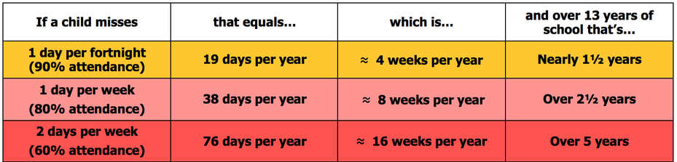
Attendance
Lunsford Primary monitors the attendance of every child in the school. We work with and support those children and their families who are not attending school without sufficient reason. Our attendance target for this academic year is 96.5% attendance.
To put this in perspective 95% sounds good, but means that your child misses:
one half day each fortnight
two weeks every school year
over three-quarters of a school year in a school career
Notes:
GA KM

Slide 10


Attendance
A key factor in a child’s success at school is regular and punctual attendance.
We will reward good attendance
We will be robust in chasing up poor attendance and children who are persistently late
Term-time holidays will not be authorised unless there
are exceptional circumstances
Notes:
GA KM

Slide 11
Uniform
The expectation is that all children will wear the correct school uniform. This includes smart, black shoes.
No such thing as inappropriate weather – only inappropriate clothing!
Sweatshirt, Polo Shirt, Black/grey trousers/skirt, summer dresses – red and white
PE Kit in to be worn on PE days
Labelled please
Order from Brigade online.
We want to foster and develop a real pride in our school from the very beginning
Notes:
GA EL

Slide 12


Slide 13
Welcome to Tiger Class!
We really want to work together with you as parents, to ensure all the children have the best year possible.

Slide 14
Our Topics
Autumn Term:
  Topics – Vikings & Anglo-Saxons and Marvellous Maps
  Science – Properties & Changes in Materials and Earth & Space
Spring Term:
  Topics – Modern Greece and Ancient Greeks
  Science – Animals, including Humans and Forces
Summer Term:
  Topics – Titanic and Enough for Everyone
  Science – Forces (2) and Living Things & their Habitats

Slide 15
Phonics / Spellings
Spellings:
  Spelling Shed lessons every week. Children can acess these words online at home.
  Occasionally, spellings will be part of the English homework (suffixes, root words etc.)
  Revision of Year 3 / 4 statutory spellings
  Learning of Year 5 / 6 statutory spellings

Slide 16
Number Bonds / Times Tables
We will continue to use TT Rockstars this year.
Please encourage your child to practice at home too, as times tables recall is so beneficial to all aspects of maths.

Slide 17
Reading
Reading is vital to learning!
Please listen to your child (even if they are fluent) at least once a week and record it in their record book. We will be using these everyday so they must be in school daily.
Buster’s Book Club is a primary school initiative that encourages children to read at home with their parents or carers. It is a motivational programme that sets achievable reading targets, collective class and school rewards for achieving those targets and doesn’t just focus on set texts but actively encourages the reading of any reading material from comics to cooking instructions.
Whatever they read and whoever they read to, the minutes are recorded and added to the class total every Wednesday morning (or the day nominated by the school) and submitted to KM Charity Team's reading database.

Slide 18
Homework
There will be two sets of homework a week and the expectation of daily reading.
Wednesday – Maths to be back by the following Monday.
Thursday – English (SPaG / Reading Comp) to be back by the following Wednesday.
Daily reading – about 20 minutes EVERY DAY.
    Buster Book Club
    Sign reading record

Slide 19
PE
Mondays with Mr Dickinson
Tuesday with Mrs Abbott ( Mr Crust Kent Cricket this term)
Outdoor Games Trainers (which might get muddy), PE t-shirt, shorts, jogging trousers, sun hat for summer, spare socks (for those wearing tights).
Forest Schools will take place every three weeks.
Children to wear PE kit on PE days
Earrings must be taken out and long hair tied back.
Please make sure all items of PE kits and uniform are named.

Slide 20
Assessment
Ongoing informal assessments during the year for reading, writing and maths
We assess the children regularly and also conduct Pupil Progress Meetings three times a year to ensure your child is on track to meet their targets.
If you have any concerns about your child and their progress, please make an appointment to see Mrs. Abbott or Mrs. Harris.

Slide 21
Online Safety
Many Lunsford children regularly use the internet and social media and we have a duty to help them keep safe online.
Users should be sixteen to use WhatsApp and thirteen to use Instagram, Snapchat, Twitter, Facebook, Skype and TikTok.
Although there is no age restriction for watching YouTube videos, users need to be thirteen to have their own YouTube account enabling them to subscribe to channels, like videos, post comments and add videos.

Slide 22
Online Safety
If your child does use social media, please help them to check their privacy settings, disable any chat settings and ensure they know how to block and report.
www.net-aware.org.uk provides lots of up-to-date information for parents.
Please let us know if there any issues regarding the online behaviour of Lunsford children at any time.
We will always follow this up within school in line with our online safety, safeguarding, behaviour and acceptable use policies.
Please see Mrs Lomax if you have any other queries about online safety.

Slide 23
Mobile Phones – Year 5 and 6
Pupils are discouraged from bringing mobile phones to school unless an absolute necessity.
If pupils in Y5 or Y6 need to bring a phone into school, a consent form must be signed by parents on Operoo
Phones must be switched off once pupils arrive on the school site and must not be turned back on until they leave the school grounds
If parents need to contact pupils, this should be done following the usual school procedure by phoning or emailing the school office.
Mobile phones should be given to the class TA first thing and these are then put in a named bag and kept in a safe place.

Slide 24
Mobile Phones – Year 5 and 6
If a pupil is found to have their mobile phone in their bag, the phone will be taken from the pupil, handed to a senior member of staff and kept in the school office. Parents will be contacted to collect the phone.
If a pupil is found to be taking photographs or video footage of either other pupils or teachers, this will be regarded as a serious offence and disciplinary action will be taken according to the School’s Behaviour Policy.
The school bears no responsibility for the loss or damage to a mobile phone
Should children not follow the Lunsford Primary School Mobile Phone Policy or Lunsford Primary School Acceptable Use Policy, the school reserves the right to withdraw this privilege and they will no longer be able to bring their phone into school.
The mobile phone consent form is available on Operoo.

Slide 25
Getting in Contact
At Lunsford, we have an open door policy. We want to work in partnership with parents and carers and strive to achieve the best for all children.
We ask that if you have any worries or questions regarding your child or a problem related to school, please do not hesitate to contact us so we can understand your concerns and help to solve any issues . If we do not know there is a problem, it is very difficult for us to help you or your child.
If you feel that an issue has not been dealt with appropriately, please speak to Mr Anscombe or Mrs Lomax, or we will happily provide you with a copy of the formal complaints procedures.

Slide 26
Getting in Contact
If you would like to speak to a member of staff…
Mrs Mead will forward on any emails and pass on any telephone messages.
Mrs. Abbott and Mrs. Harris can be contacted via Class Dojo. We will try to reply as soon as possible (within 24 hours during the week) but urgent messages should be sent via the office as we will not necessarily be able to access Dojo whilst we are teaching!
A member of the Senior Leadership Team will also be available on the playground every morning and afternoon.
Our Family Liaison Officer (FLO) Amy Taylor can be contacted on 07552 045390.

Slide 27
Lunsford Primary School
Welcome to our school!

