Slide 1
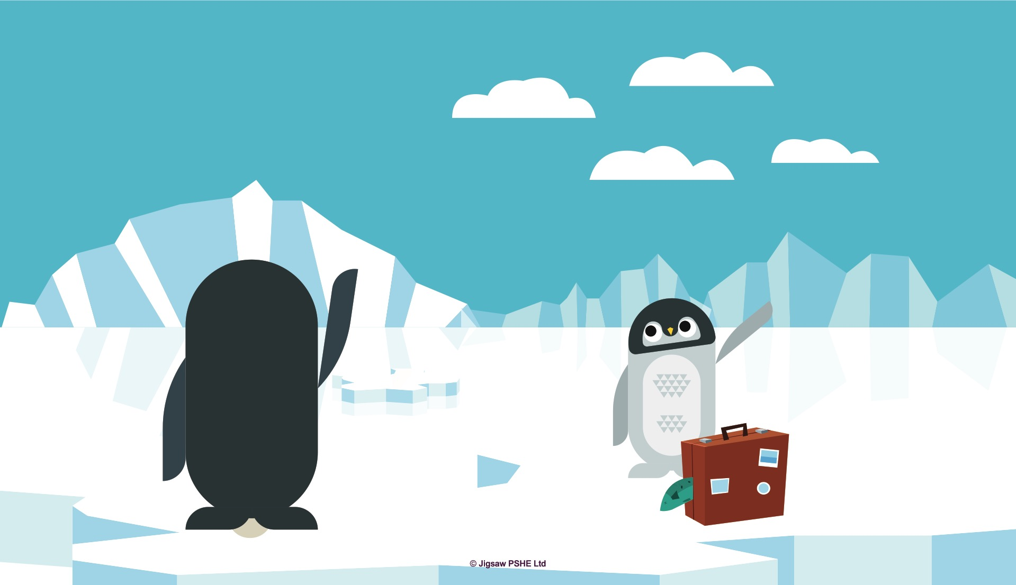
Notes:
Note for teacher: Pauli is one of the characters from the Jigsaw Families Programme so some of your children may recognise him. You can find out more about Jigsaw Families at https://families.jigsawpshe.com
Pauli was a penguin who lived in the snowy Antarctic. Antarctica is a very cold place at the bottom of the world. Did you know that penguins live there?
Pauli had a very special partner called Marta who he loved very much. Like all penguin couples, sometimes they spent a little while apart from each other. When they were old enough the mummy penguins would lay an egg and leave it with the daddy penguins to hatch. The mummy penguins would march across the snowy land to reach the sea where they all had a rest and ate lots of fish. It’s very hard work laying an egg you know, so they deserved a holiday!
When the mummy penguins came back, it would be time for the daddy penguins to have their holiday. It’s very muddling isn’t it?

Slide 2
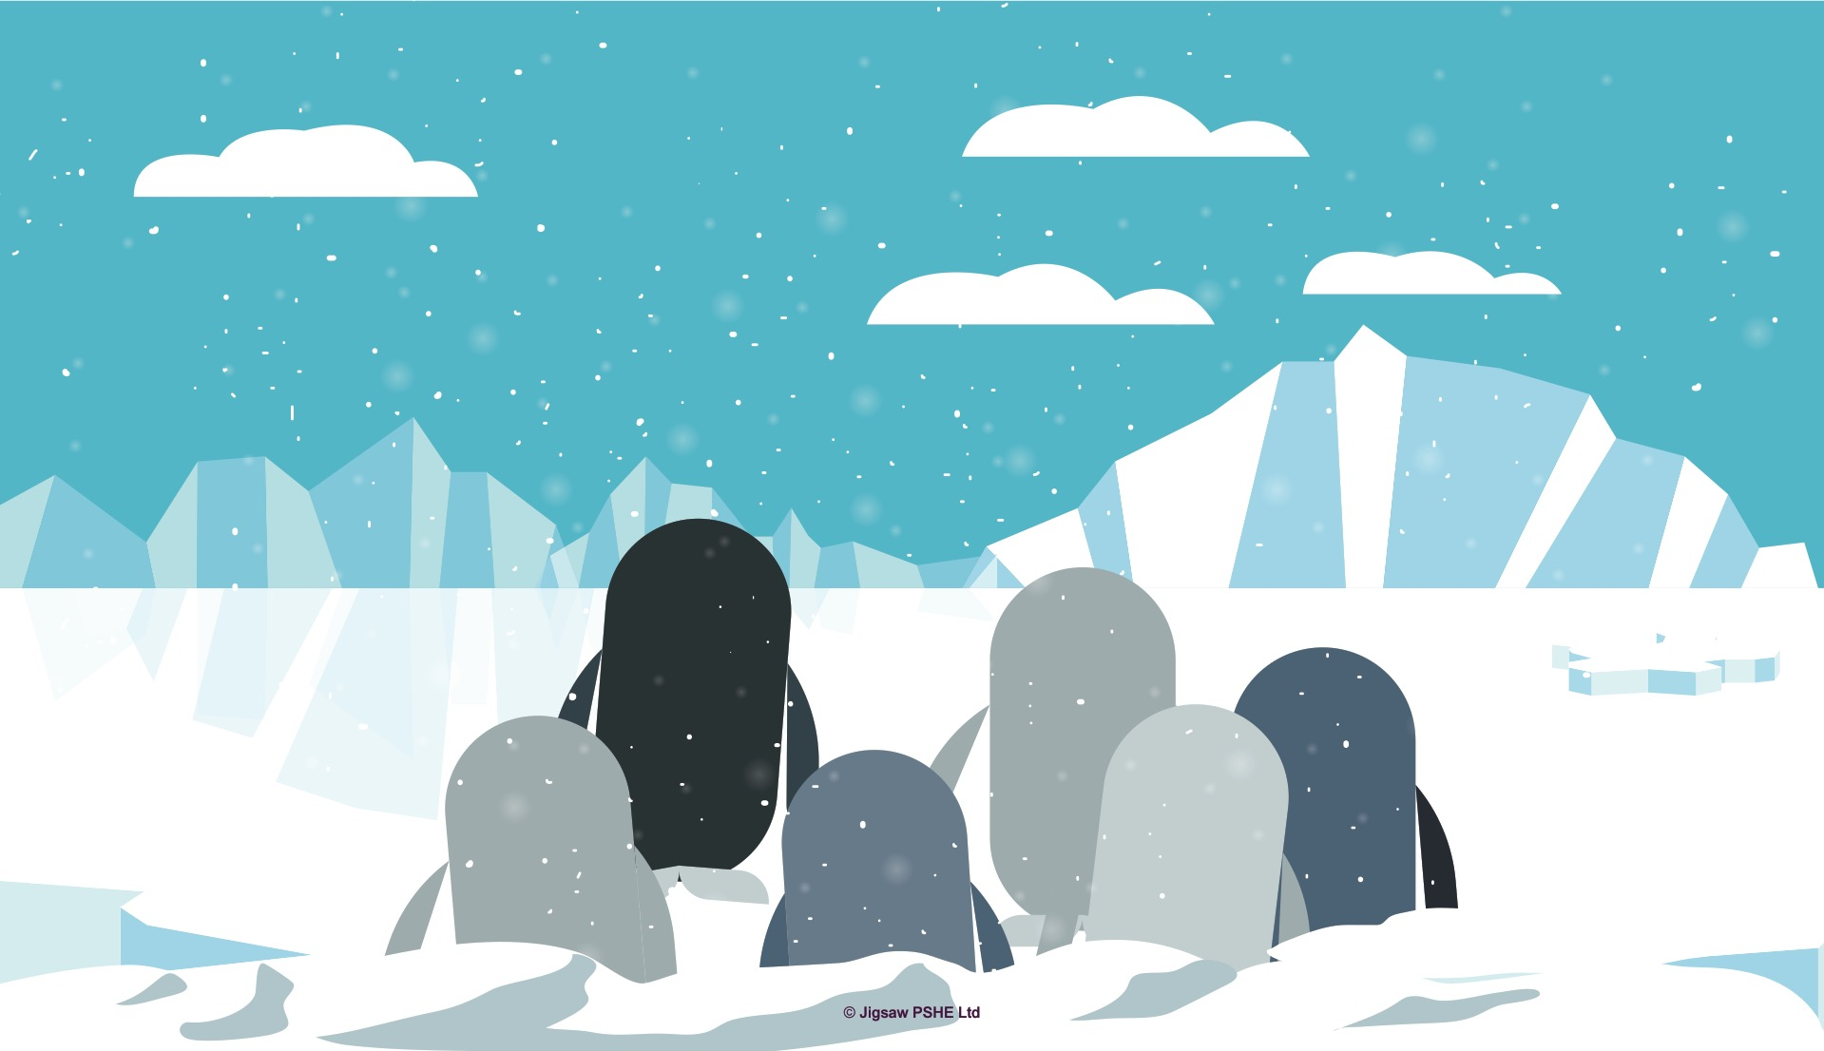
Notes:
Today’s story is about Pauli’s trip. Marta had just come back from the sea so it was time for Pauli to join all the other daddy penguins for their holiday.
Pauli waddled along the icy and snowy land. There was a LONG way to go so it was going to take a few weeks to reach the sea.
In the first week there was a terrible snow storm and the wind blew so hard that Pauli and the other penguins had to stop walking and had to huddle together to keep warm.
[Invite the children to mime the snow storm, or mime Pauli and the penguins huddling to keep warm.]

Slide 3
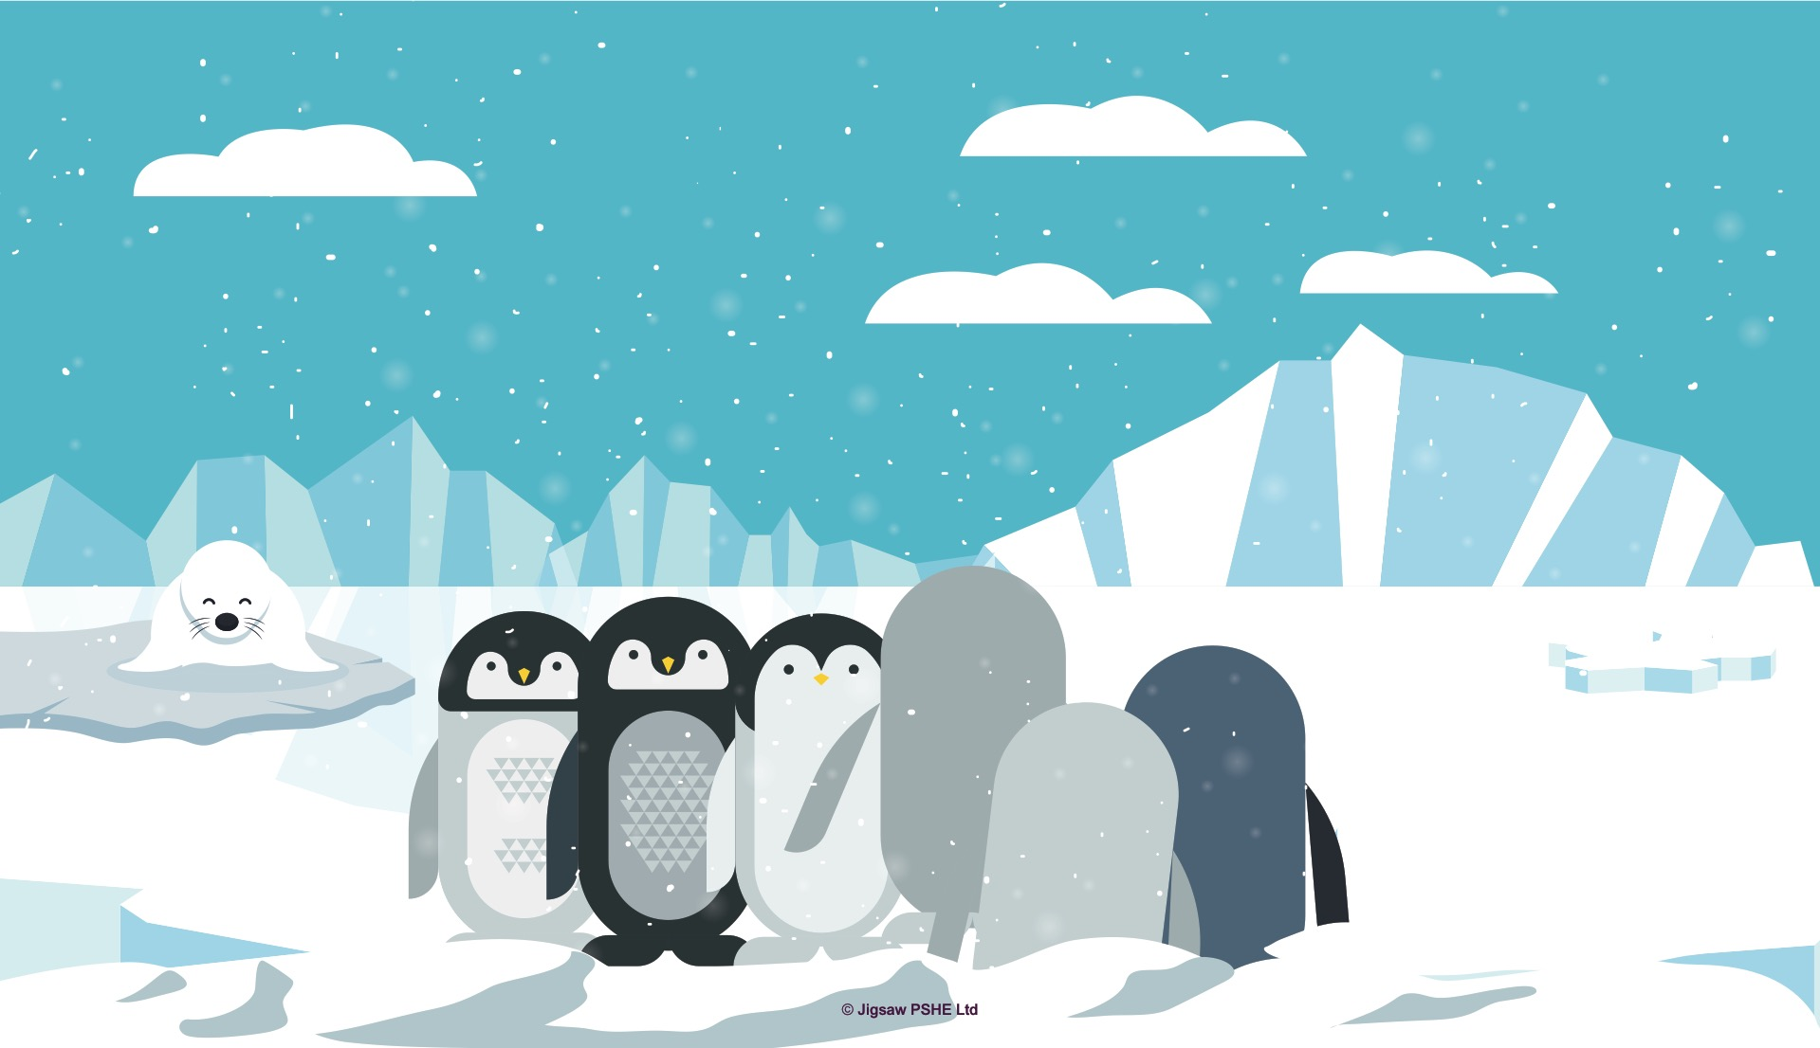
Notes:
In the second week, there was icy- rain that made it slippery to walk along, so the penguins had to step very carefully and slowly to stop themselves from falling over.
[Invite the children to mime the icy rain falling with their hands and fingers. Ask the children how the penguins might be feeling.]
In the third week, they reached the place where the seals live. Seals don’t think twice about gobbling up a penguin for a snack, so the penguins had to walk very quietly and quickly so they couldn’t be caught.
[Invite the children to make themselves small so they won’t be seen and put their fingers on their lips to be quiet. Ask how the penguins might be feeling.]

Slide 4
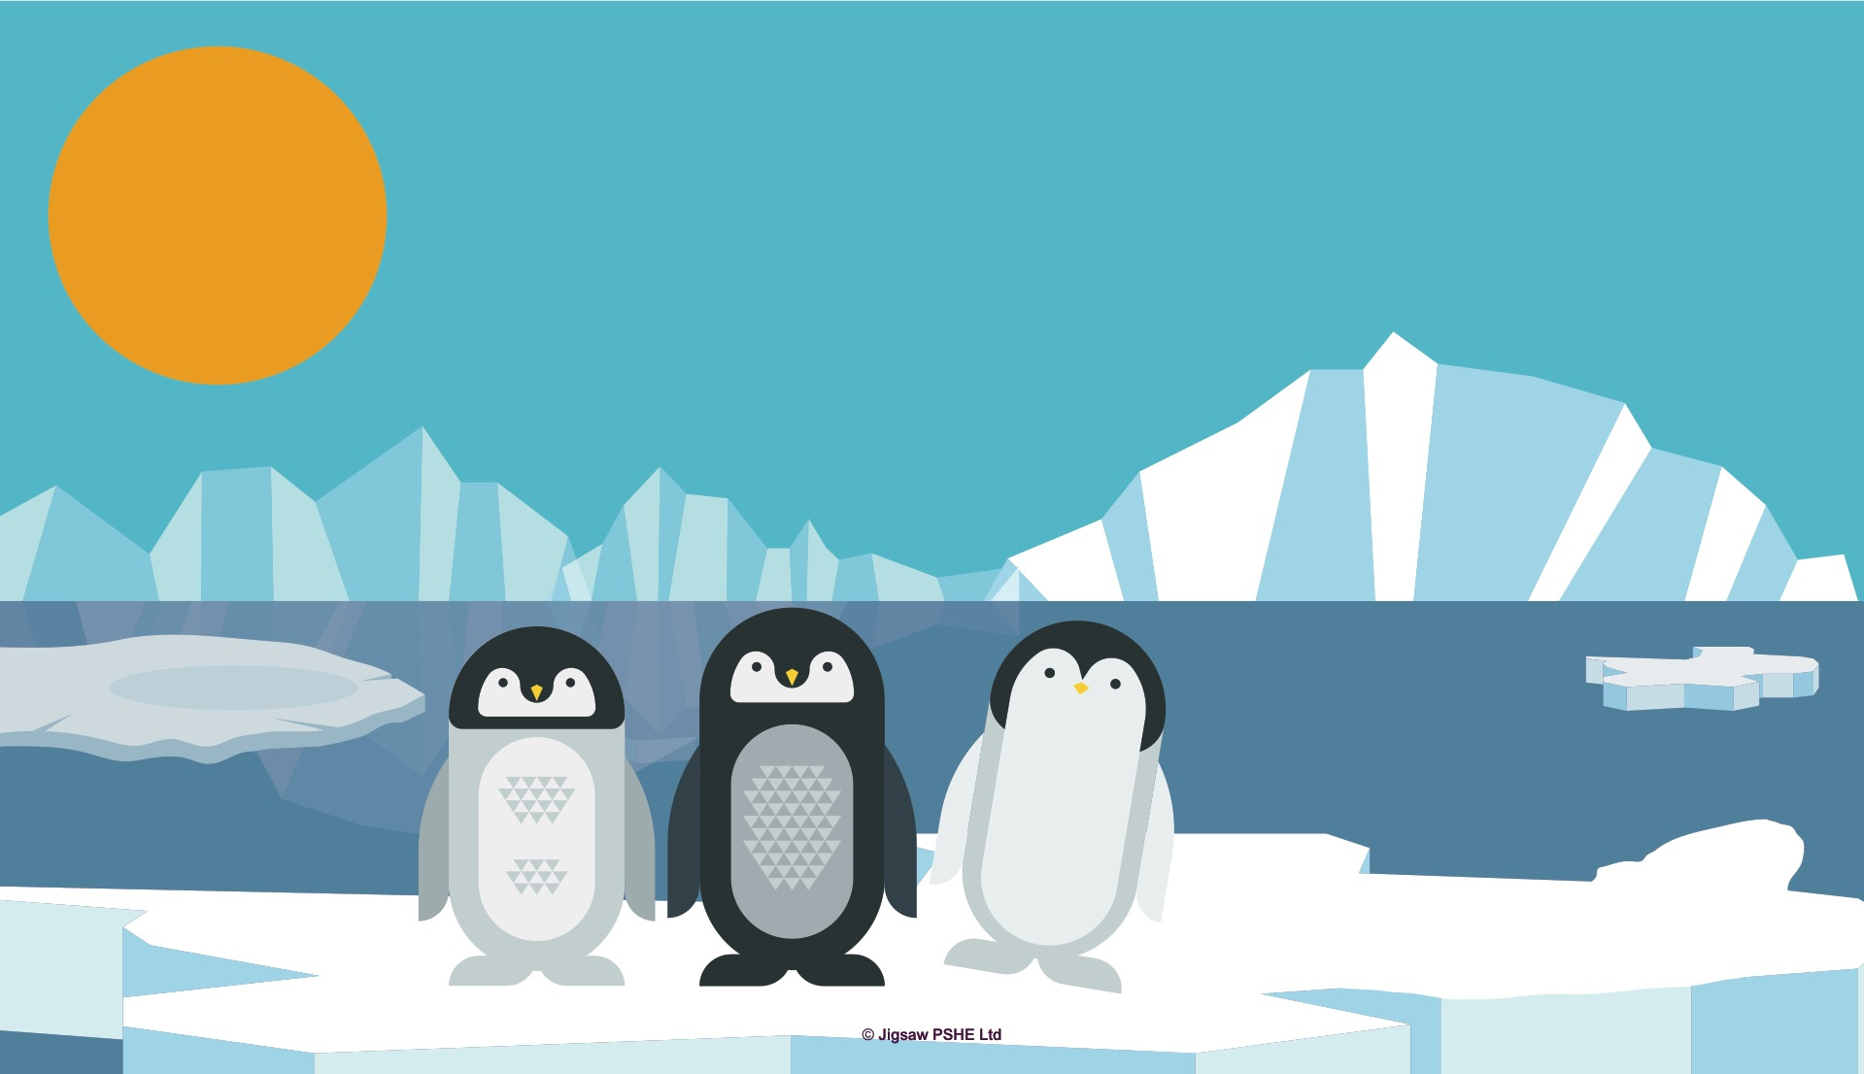
Notes:
In the fourth week, there was bright sunshine, the snow started to melt and the ice broke apart so it slowed down the penguins’ journey.
[Invite the children to mime the sun coming out with their hands. Ask how the penguins might be feeling.]
On the fifth week, the penguins could see the sea. They were nearly there! Pauli and the other daddy penguins were feeling very tired, but they just had to keep going. When one penguin fell behind the others, someone would nudge them along and give them encouragement to keep going. It was safer for the penguins to travel in a group.
[Invite the children to offer suggestions as to what they might say to encourage Pauli and the other penguins to keep going.]

Slide 5
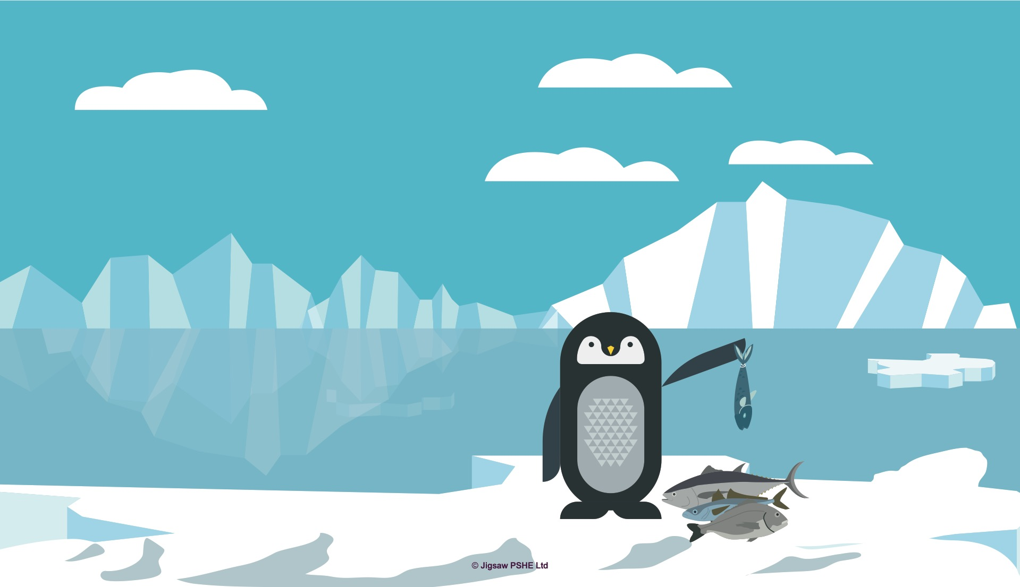
Notes:
On the sixth week, they finally reached the sea. Pauli and the other penguins were so pleased. It had taken a long time and every day had been a struggle, but they had made it. Pauli dived into the sea and started to catch lots of fish to eat. He was very hungry.
[Ask how the penguins are feeling now. Invite the children to congratulate Pauli and the other penguins for succeeding in their challenge.]

Slide 6
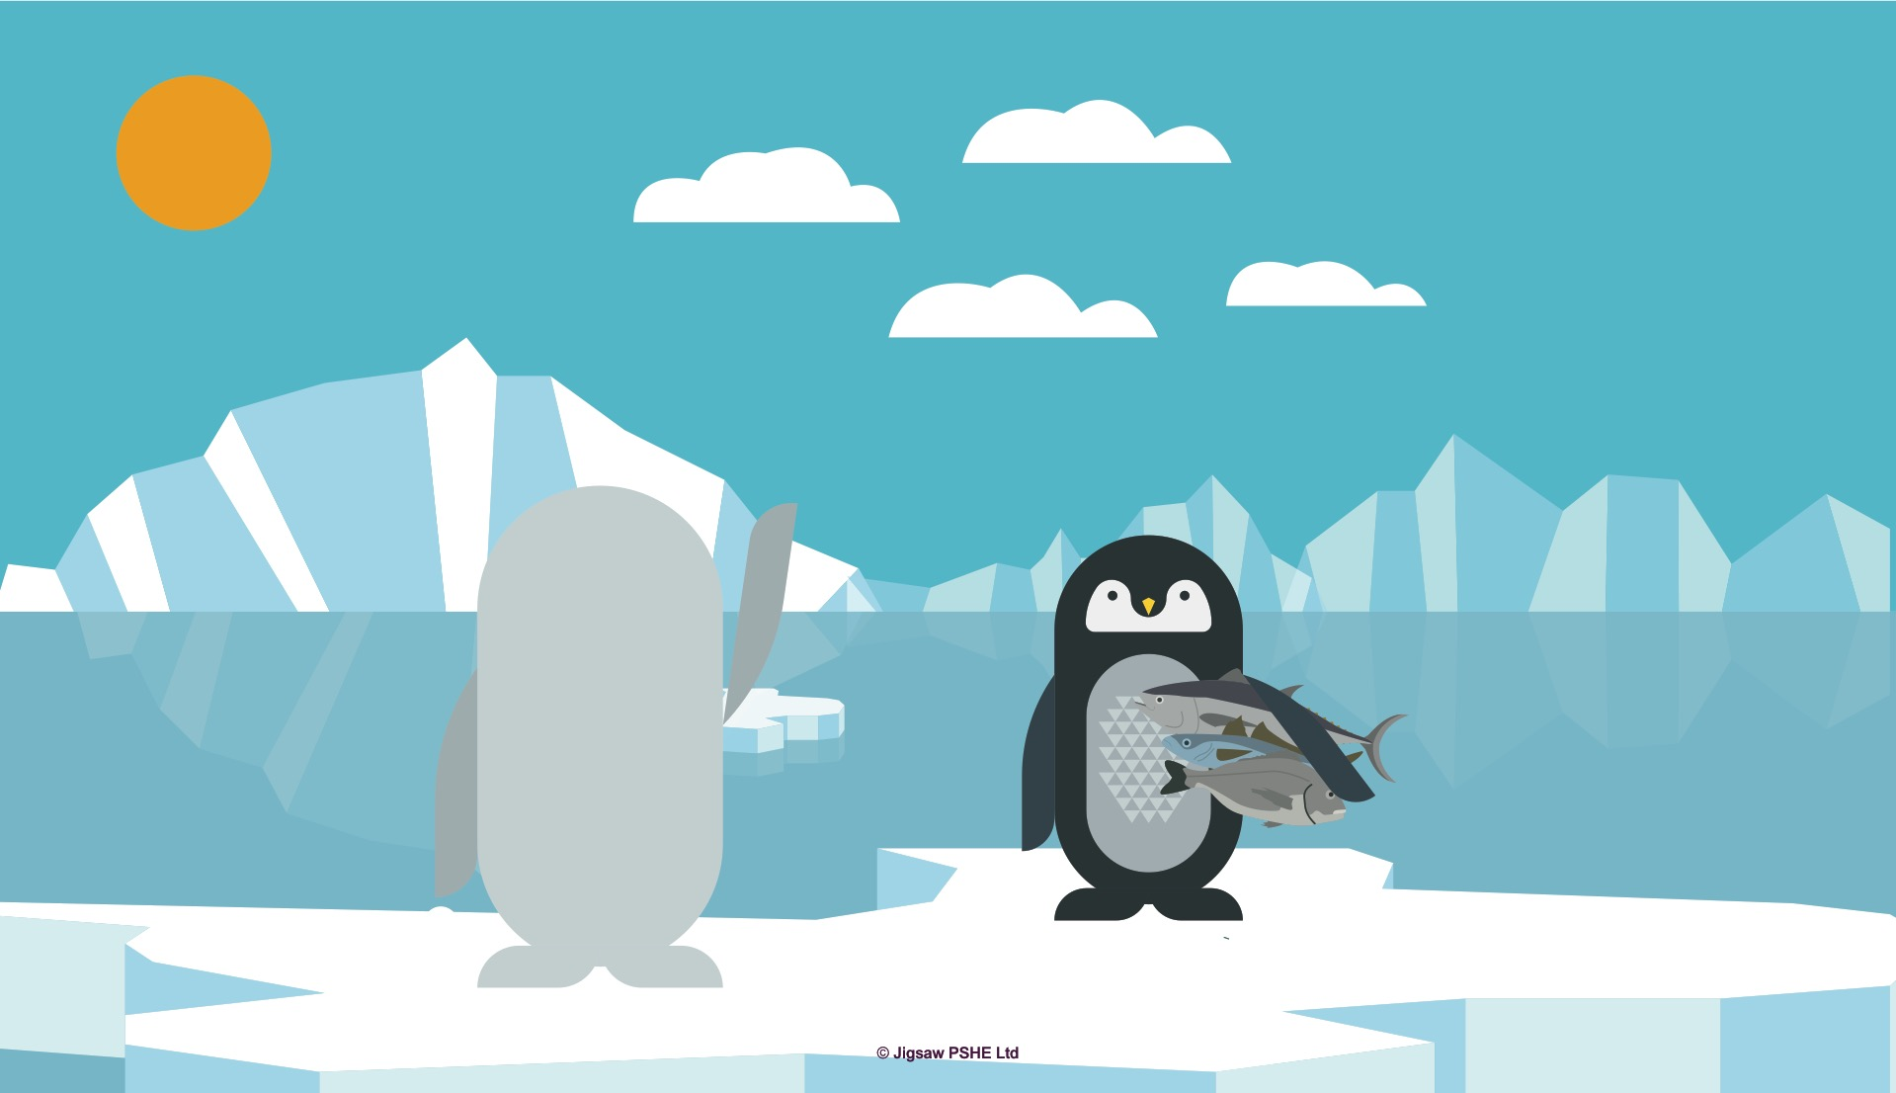
Notes:
Pauli and the others stayed at the sea for a few weeks and then it was time to make the long journey back. It’s tough being a penguin isn’t it?

