Slide 2

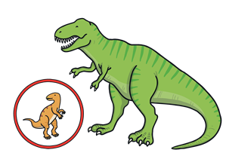
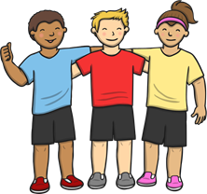
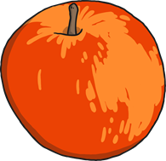
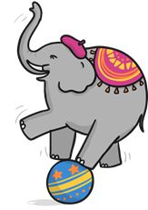

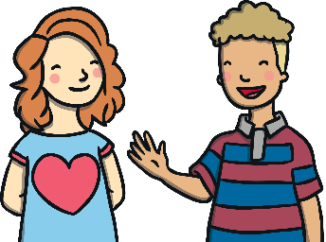
/l/ Spelt ‘le’
The sound /l/ is often spelt with ‘le’ at the end of words, after two consonants (such as ‘pp’, ‘tt’ or ‘dd’).
apple
bottle
little
middle
wobble
dazzle
riddle

Slide 3
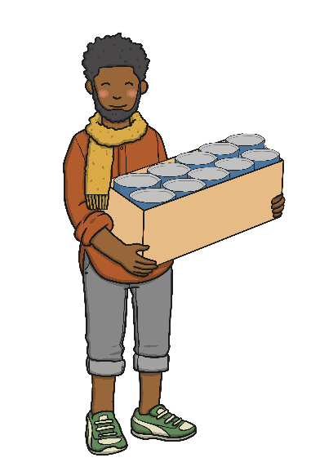
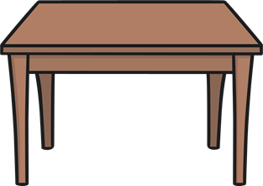
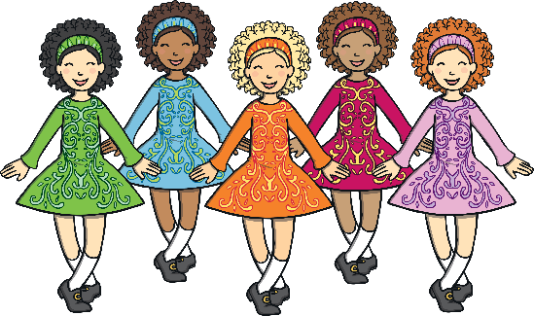
Be Careful!
The sound /l/ is sometimes spelt with ‘le’ at the end of words, after just one consonant.
table
able
multiple

Slide 4
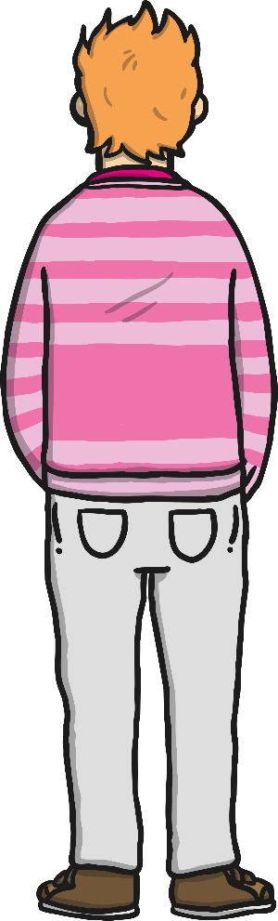

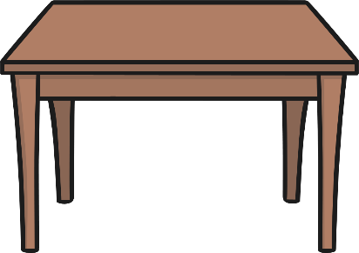



/l/ Spelt ‘le’
The sound /l/ is often spelt with ‘le’ at the end of words, after two consonants (such as ‘pp’, ‘tt’ or ‘dd’).
The sound /l/ is sometimes spelt with ‘le’ at the end of words, after just one consonant.
Can you air write an ‘le’ with your finger?
Can you write an ‘l’ on your table or the carpet?
Can you write either an ‘le’ or an ‘l’ on a partner’s back?
Can they tell what letters you have written?

Slide 5
Here are this week’s spellings to practise.
table
apple
bottle
little
middle
able
wobble
multiple
dazzle
riddle

