Slide 2
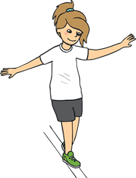
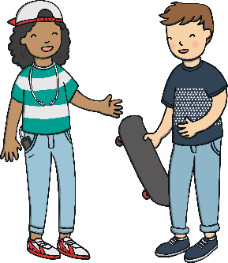
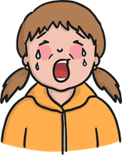
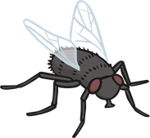
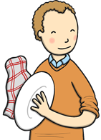
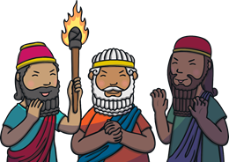
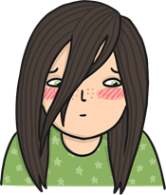
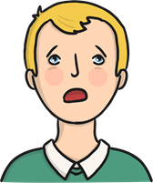


/igh/ Spelt ‘-y’
The /igh/ sound at the end of these words is spelt with ‘-y’.
cry
fly
dry
try
reply
2x3=6
sly
shy
terrify
sky
multiply

Slide 3
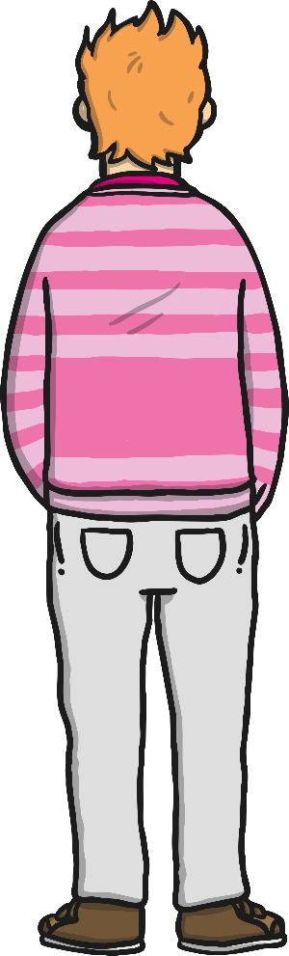

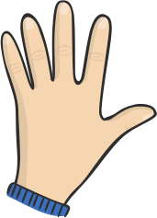




/igh/ Spelt ‘-y’
The /igh/ sound at the end of these words is spelt with ‘-y’.
Can you air write an ‘-y’ with your finger?
Can you write either an ‘y’ or an ‘igh’ on a partner’s back?
Can you write an ‘igh’ on the back of your hand?
Can they tell
what letters you have written?

Slide 4
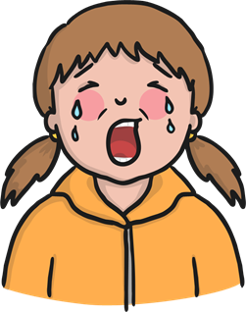
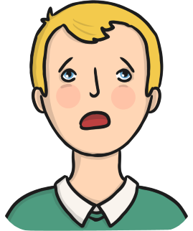
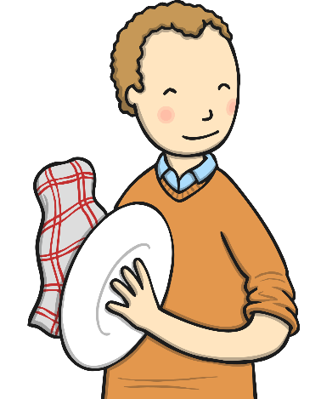
Be careful!
The sound /igh/ sound is usually only spelt with ‘-y’ at the end of a word.
cry
terrify
dry

Slide 5
Here are this week’s spellings to practise.
cry
fly
dry
try
reply
sly
shy
terrify
sky
multiply

