Slide 1
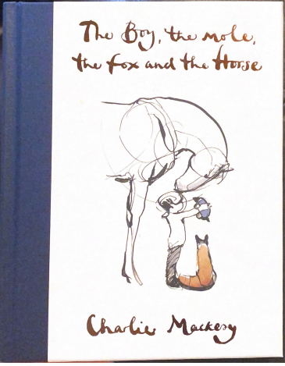
Monday 1st March
Look at the whole school text that we are looking at this week. It is about four characters that go on an adventure. Along the way, they share affirmations and messages with each other to support their friends.
Look at the front cover of the book. Have you seen any of Charlie Mackesy’s illustrations before? Where?
Discuss the style of the illustrations. They are ink and stick drawings. They are made using a stick, dipping it into the ink, how we used to write.
What do you like about the illustration? Why?
Write a prediction about what you think happens in the story. What might the characters get up to? Where might they go? What adventure could they have?

Slide 2
Read the introduction letter from the author.
Can you spot any features of language used by the author such a simile? What do you like about the letter?
What is different about this story? What does the author encourage you to do when reading this book? Is that different to how you have read books before?

Slide 3
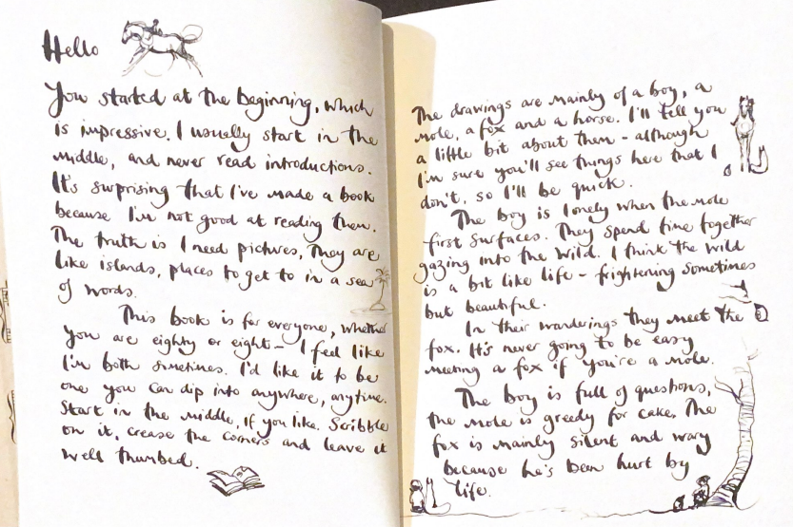

Slide 4
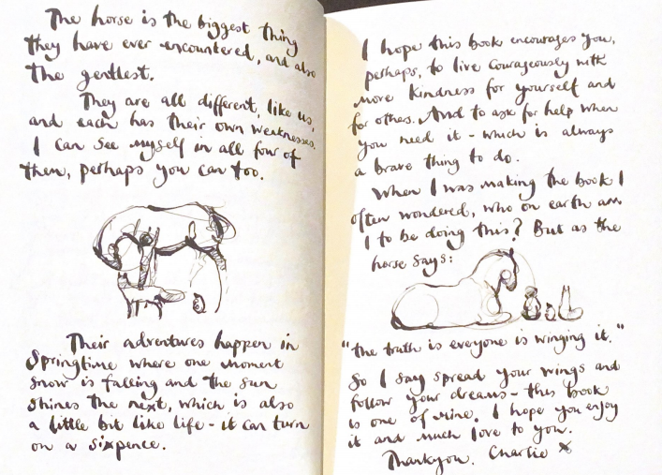

Slide 5
Fill in the table with the information you have gathered from the author’s introductory letter.
For example, we know that the boy is lonely to start off with. So in the box you can add lonely before he meets the mole.
Words/phrases that describe the Boy | Words/phrases that describe the mole | Words/phrases that describe the fox | Words/ phrases that describe the horse | Where/when is the story set?
Lonely before he meets the mole.

Slide 6
Tuesday 2nd March 2021
Read the pages of the books on the next slides of the Power Point.
How do those pages of the book make you feel? What do you think about the Boy and how he treats the mole? What words make you think this?
Why do you think being kind is so important?
I want you to think of time when someone was kind to you and write a paragraph about it. Use these questions to help you to structure your writing.
Who was kind to you?
Why were they kind to you?
How did it make you feel that someone showed you that kindness?
Did it inspire you to pay the kindness forward? Why/why not?
If you did pay the kindness forward, what did you do?

Slide 7
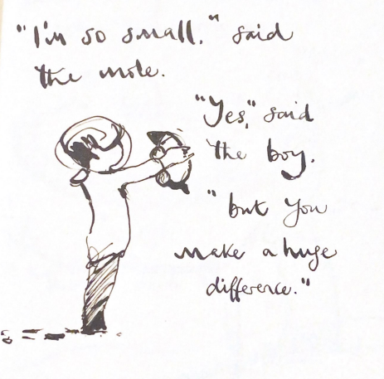
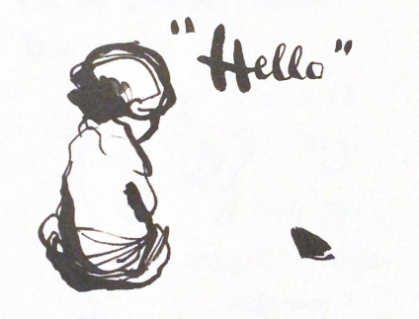

Slide 8
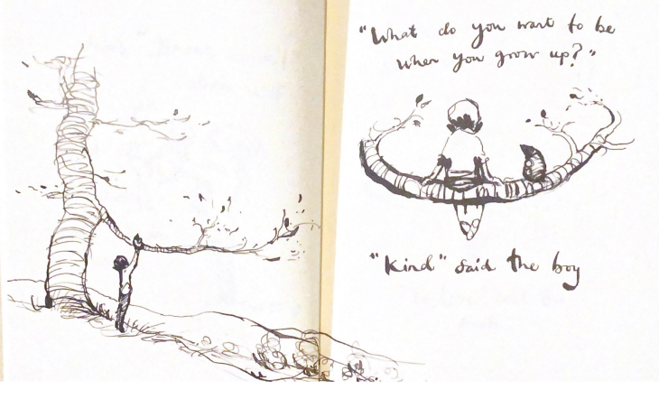

Slide 9
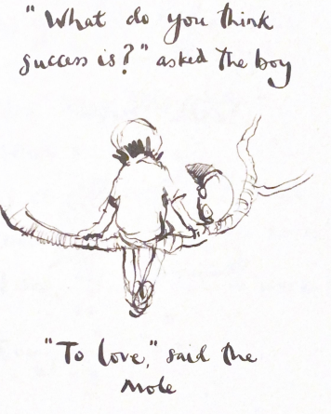
Look at this picture.
What do you think this illustration means? What does success mean to you?
Write a short description of what you think success looks like or feels like in your life?
Why do you think mole said that love means success?

Slide 10
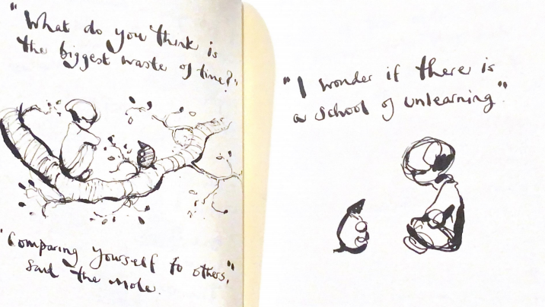
Wednesday 3rd March What does it mean that comparing yourself to others is the biggest waste of time? Have you ever done this? How did it make you feel when you compared yourself? What is a school of unlearning? Sometimes we wish we had what our friends had or we want to be like them. But you are all special and unique in your own ways and need to celebrate this.

Slide 11
Look at the next illustration from the text on slide 12.
Discuss it with an adult.
What are your dreams and hopes for the future?
Use the template with the illustration at the top to write what you hope you will achieve or do in the future. This could be in terms of a job/career, your education, you as a person, how you want to act, any goals that you wish to achieve.
Try to write down reasons for wanting to make these your goals and how you might achieve them. Think about what you can do to make them a reality such as being courageous and training if you want to climb a mountain. Or studying science in school or university if you wish to be an archeologist.

Slide 12
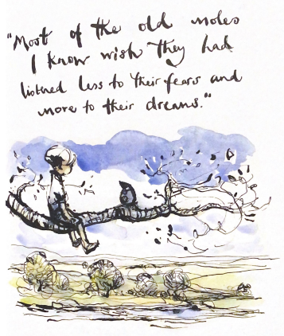

Slide 13
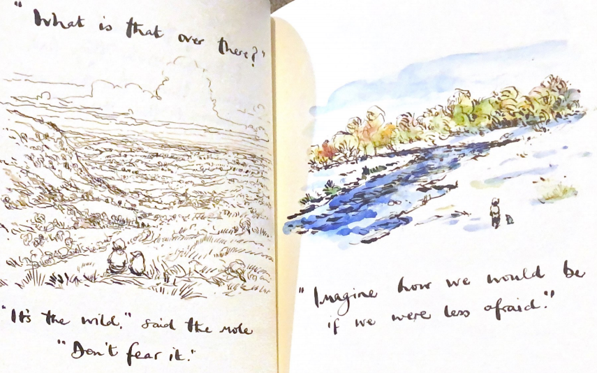
Look at the next illustrations. Discuss how they might inspire you to reach your dreams and goals. Be less afraid.

Slide 14
Thursday 4th March WORLD BOOK DAY
Today we would like you to come up with your own saying or quote in the style of the author.
What advice would you give someone? How can we make this look like the rest of the story? Have a think about the themes already used in the story and how these help you to be a positive person and have hope. Think about this year and lockdown, how could you think of a quote that might inspire people?
Have a go at creating a new page of the book. If you have black paint or ink you could even try and write it in the same style as Charlie Mackey.
We also would like you to try and create an illustration to go with your quote.
You might want to do a draft first and then a final draft.
Remember if a character is speaking, you need inverted commas and he also uses said a lot so use the same style.

Slide 15
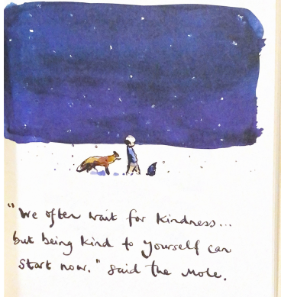
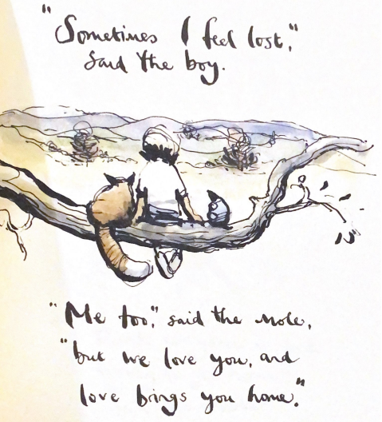
We have included some pictures of some more pages of the book to help inspire you to make up your own.

Slide 16
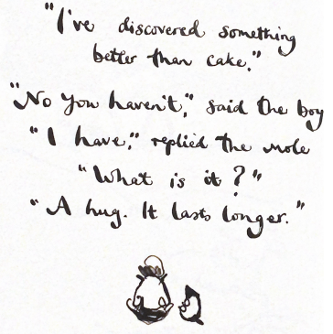
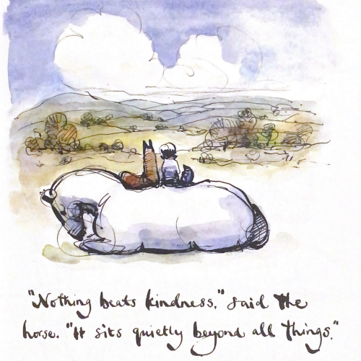

Slide 17
Friday 5th March
At the end of the story we find out that the magnificent horse has a secret talent. Read the slides which explains what it is.
Horse is the biggest thing they have encountered, but the gentlest.
Look at the beautiful illustrations that are included in the story where we discover the wings of the horse.
Can you write a short adventure that the characters can go on now that the horse has wings? Where would they go? What would they see? How did they feel?
I expect ¾ of a page of writing. Use exciting verbs and adjectives to describe their adventure. What language could you use to add detail? Could you add a simile? Can you describe the setting of where they go? What is it like for them flying? What might they see below? Think about the thoughts and feelings of each character. Can you include those feelings?
If you have black paper and chalk, can you create a drawing of the winged horse to add to your mini adventure story?

Slide 18
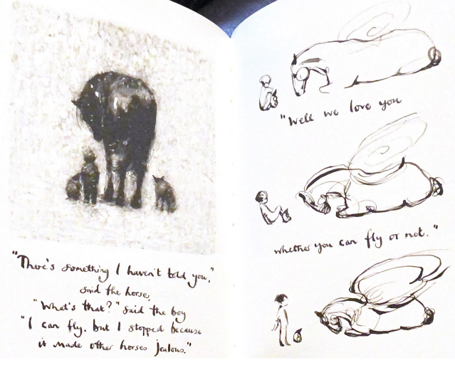

Slide 19
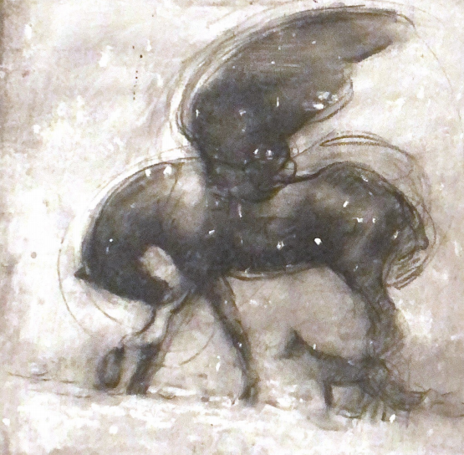
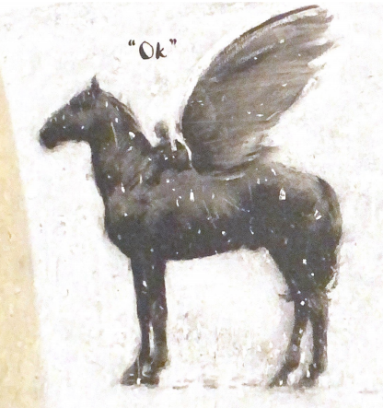

Slide 20
