Slide 1

Year 3 / 4 English
1st – 5th February
Leon and Bob
by Simon James

Slide 2
Monday 1st February 2021
Making story predictions and developing an understanding of characters
Look carefully at the front cover of the book.
What are your predictions for the text? What do you think the story might be about? What do you think will happen to the characters? Where do you think the story is set?
Write a sentence for each of your answers. Remember to punctuate them correctly with capital letters and full stops.

Slide 3
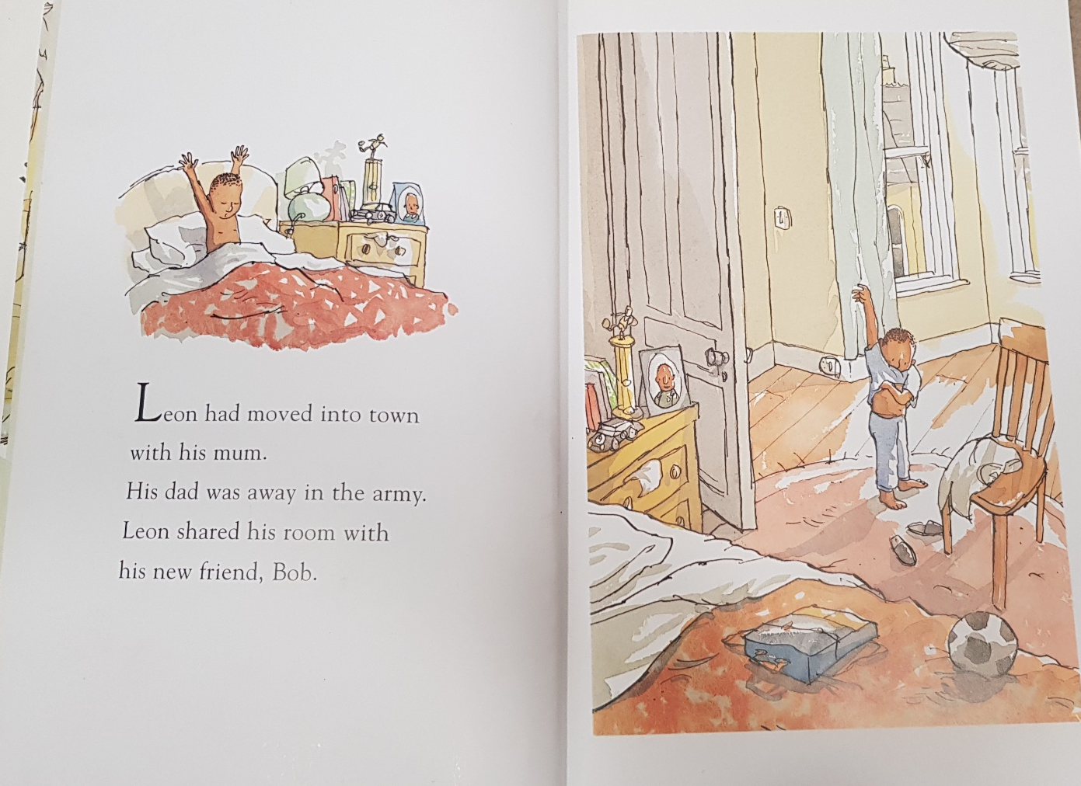
Read the first page of the book.
Look carefully at the picture. What can you see? What do we know about Leon?
Write at least two sentences to explain your thoughts.

Slide 4
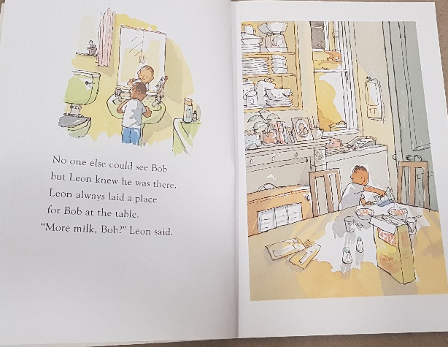
This is the next page of the book.
What have we found out about Bob? Why can no one else see him?
Write a sentence to explain who you think Bob is.

Slide 5
Tuesday 2nd February 2021
Writing a character profile
What have we found out about the story so far?
Who is Leon? Who is Bob?

Slide 6
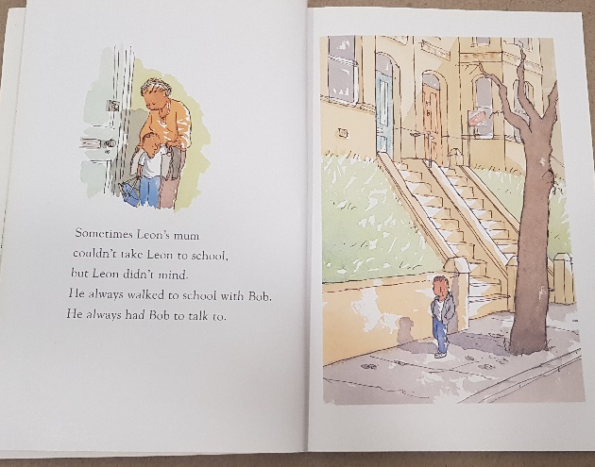
This is the next page of the story for you to read.
Today we are going to be thinking about characters.
The main character in this book is Leon.
What do we know about him so far?
Write down some notes or you could use a brainstorm like the one below.
Leon

Slide 7
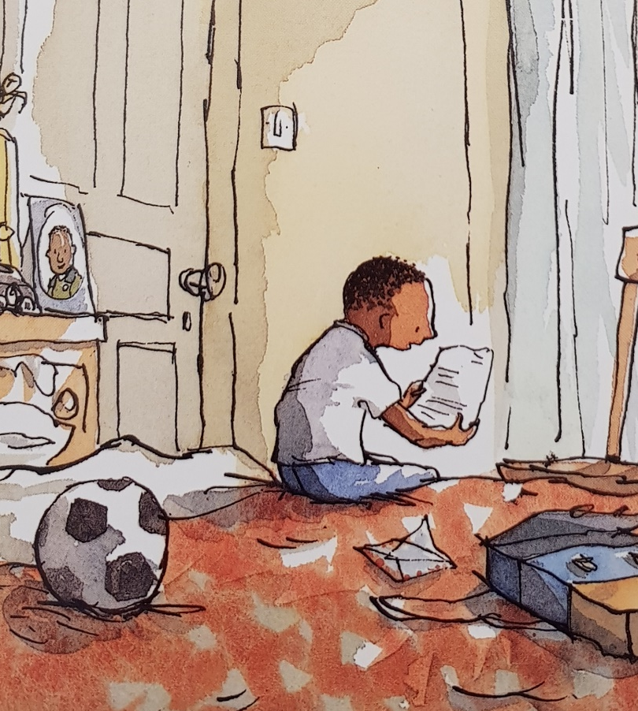
Now think about these questions…..
How old do you think Leon is?
Where does he live?
Who does he live with?
Who doesn’t he live with and why?
Who is Bob?
What does Leon do with Bob?
Why might Leon have an imaginary friend?
Try to add some more information to your notes or brainstorm

Slide 8
Now you are going to use your notes to write a character profile about Leon explaining what we know about him so far and what we think about him.
Here is an example opening to help you out.
Leon is the main character in ‘Leon and Bob’. He is a young boy who has just moved into town with his mum. From looking at the illustrations, I think he is about eight years old. Leon’s dad does not live with him as he is away in the army.
I think Leon might be lonely because….
In the text….

Slide 9
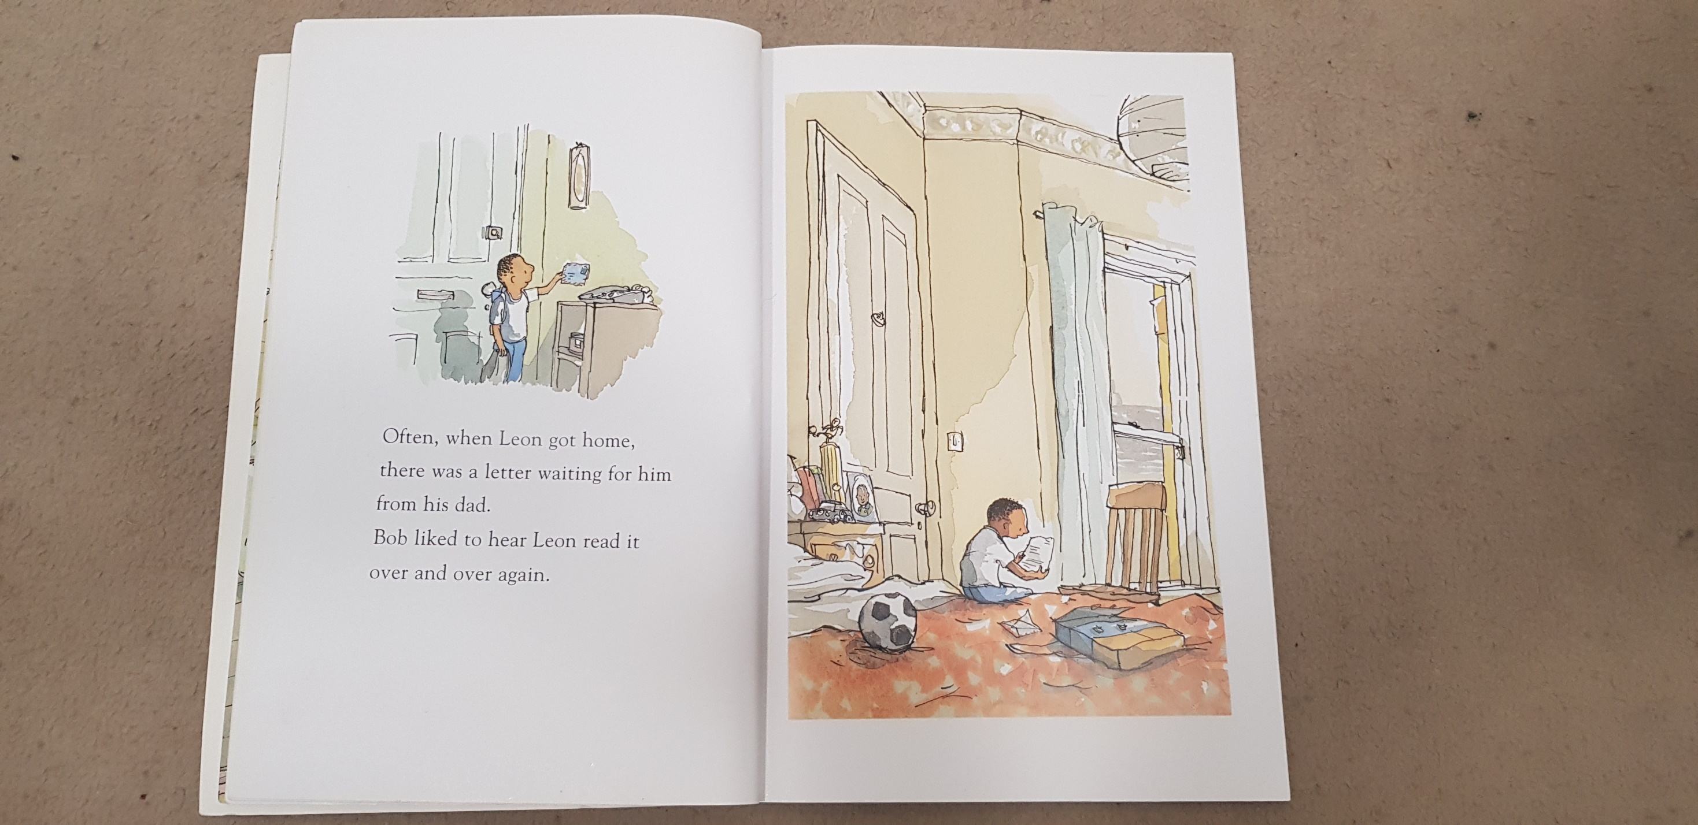
You need to write in full sentences and correct punctuation. Year 4 should try to write in paragraphs. Try to explain your ideas using the text and think carefully about the words you are using.
Remember to check your work through carefully including spellings and punctuation.
Can you improve your vocabulary? Find a word in the thesaurus and choose a more interesting alternative. Or change a word if you have repeated it a lot.
If you do not have a thesaurus at home you can use https://kidthesaurus.com/

Slide 10
Wednesday 3rd February 2021
Writing a letter in role as a character
Remind yourself about the story so far.
This is the next page for you to look at.
Why does Leon’s dad send him letters?
How do you think Leon feels when he receives one?

Slide 11

Today you are going to imagine that you are Leon and write a letter to Leon’s dad. Think carefully about what Leon might say. You can use information from the text to help you and your imagination to make up some extra details.
Leon’s life in his new home / new town. What is his new home like? What is his day to day life like? What is his school like?
Leon’s thoughts and feelings.
Questions he might ask his dad about his life away from home in the army. What are his army barracks like? The food? When will he be home next?

Slide 12
22 Park Street
Maidstone
Kent
3rd February 2021
Dear Dad,
So much has happened since your last letter. Last week Mum and I moved into the new house in town. It is huge! My bedroom is really cosy and decorated in my favourite colours although I still miss my old room.
What is your room like at the barracks? On my bedside table I have all of my shiny football trophies plus my favourite picture of you in your dark-green uniform. I can’t wait to play football with you in the park next to our house.
Here is an example letter opening which might help you with your work.
Remember to write in first person (I, we, me) as you are imagining you are Leon. Try to include interesting details.
Check your work through carefully.

Slide 13
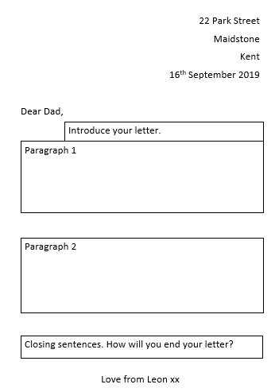
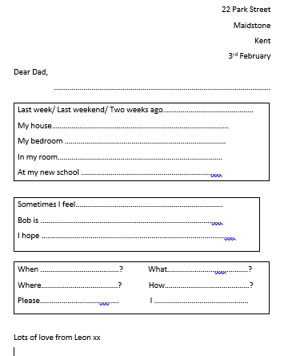
These also might help you to plan and organise your work.

Slide 14
Thursday 4th February
Writing a description
Look at the picture of Leon’s bedroom. His room contains evidence of his life and reflects who he is a person, his family and his interests.
Write a list of things you can see in Leon’s room. Try to add some adjectives to describe them.
Eg. shiny, gold football trophy
messy, crumpled clothes
cosy bed with a soft, red duvet
These are all expanded noun phrases

Slide 15
Prepositions
about
above
across
after
against
along
among
around
at
before
behind
below
beneath
beside
between
by
down
during
except
for
from
in
in front of
inside
instead of
into
like
near
of
off
on
onto
on top of
out of
outside
over
past
since
through
to
toward
under
underneath
until
up
upon
with
within
without
Look at this word mat to remind yourself what prepositions are. They explain where or when things are in relation to something else.

Slide 16

Add some prepositional phrases to your ideas about Leon’s bedroom
Eg. on the shelf / under the bed / in the drawer
You are now going to use your ideas to write a description of Leon’s bedroom. Remember to write in full sentences and include prepositions and expanded noun phrases. Check your full stops, capital letters and commas. Try to include lots of interesting vocabulary and use a dictionary or thesaurus if you have one.
Year 4 please try to write in paragraphs ☺

Slide 17
Friday 5th February
Writing a poem
Earlier in the week we looked at then wrote about Leon’s bedroom.
Have a think about your own room. What is in there? What things are special? How is it decorated? What are your favourite memories?
Create a brainstorm to show your ideas. Try to include some expanded noun phrases and prepositions.
Old photographs of precious memories pinned to the wall
My bedroom
A cuddly, well-loved bear snuggled under the duvet

Slide 18
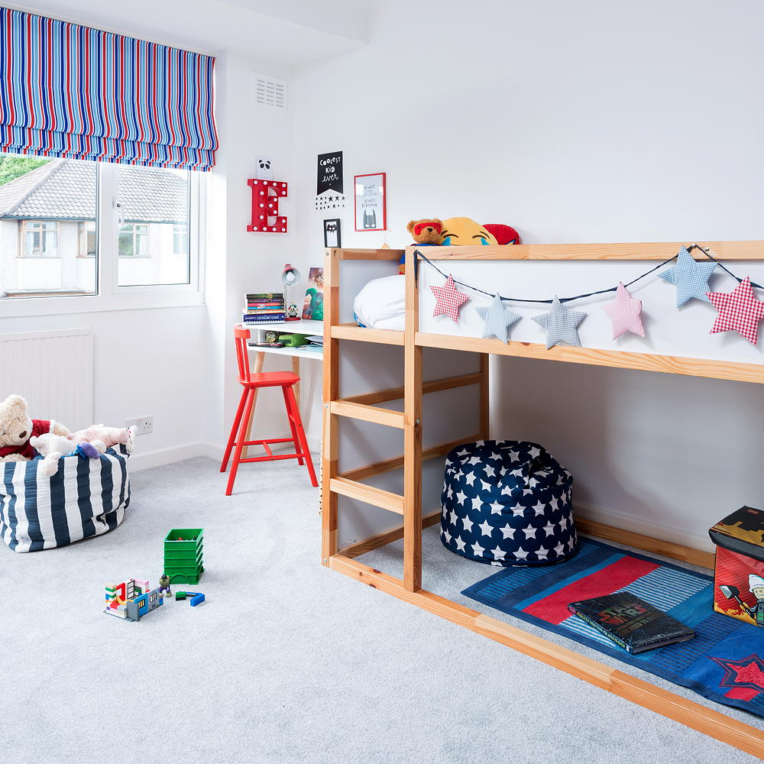
You are now going to use your ideas to write a poem about your bedroom. If you prefer you can write about an imaginary room. Remember to start a new line (with a capital letter) for each idea. You might wish to use some of these sentence starters to help you. Remember to give your poem a title.
In my room…
On my wall…
Under my bed I keep…
In the corner….
On the shelf…
Behind my chair…
Through my window…
It’s a special place because….

