Slide 1
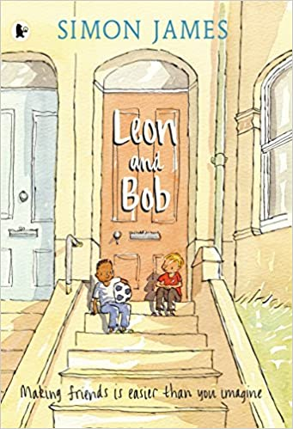
Year 3 / 4 English
8th – 12th February
Leon and Bob
by Simon James

Slide 2
Monday 8th February 2021
Write a diary entry in role as a character
https://www.youtube.com/watch?v=M2TniloDMM4
Watch the YouTube video to hear the full story of Leon and Bob.
Was the story what you expected based on what you read last week? What else do we find out about Leon? Does it remind you of any experiences you have had? At the end of the story how do you think Leon feels to have a friend?

Slide 3
Your task is to write a diary entry in role as Leon about how it feels to finally have a friend. Think about what Leon might say. How might he be feeling? How are things different for Leon by the end of the story?
Remember to write in first person as if you are Leon eg. I, me, my.
Be sure to check your work through carefully then try to use a different coloured pen or pencil to edit and improve your work – just like we have our purple pens in school.

Slide 4
Tuesday 9th February 2021
Write a conversation between Leon and Bob
Try to think of as many different words as you can use that you could use instead of ‘said’. Eg. Shouted, whispered, answered. Write them down. Try to think of at least 10.
Try to add some adverbs to some of your ideas. Remember adverbs describe a verb. Eg. Leon shouted loudly. Loudly is an adverb as it describes how Leon is shouting.

Slide 5
Listen to the story again if you need to. At the end of the story Leon and Bob go to the park together. What do you think the next scene would be? What might the characters do? What conversation might they have?
Your task is to write a conversation between Leon and Bob. Remember if someone is speaking, we need to use inverted commas (speech marks).
Eg. “What are your hobbies Leon?”, said Bob.
There is more information here if you are unsure
https://www.bbc.co.uk/bitesize/topics/zvwwxnb/articles/ztcp97h

Slide 6
When you are writing the conversation between Leon and Bob you need to put inverted commas “ ” around what they are saying.
Remember to also start a new line when each person starts talking.
“How long have you lived here?”, asked Bob curiously.
“Only a few months”, whispered Leon quietly. “I live with my mum and my dad is away in the army”.
“Wow! That is interesting”, Bob replied.
“Do you enjoy playing football?”, Leon mumbled nervously.
Remember!
Try to use more interesting words than said.
Use inverted commas to show what the characters are saying
Start a new line for a new speaker
Check your work carefully

Slide 7
Wednesday 10th February 2021
Write a description of a good friend
Think about what having a friend means to Leon.
Why are friends important to you?
What makes a good friend?
What special memories do you have with your friends?
Write at least two paragraphs describing what makes a good friend. Try to use some good descriptive language and explain your ideas.

Slide 8
Thursday 11th February
Write a book review
We hope you have enjoyed the story of Leon and Bob.
Today you are writing a book review of the story. We would like you to explain:
Who are the main characters and what is the story about?
What did you like about the story? What was your favourite part and why?
Which are your favourite illustrations and why?
Is there anything you did not enjoy about the story and why?
Who would you recommend the story to and why?
Here is a link to the story being read if you want to watch it again
https://www.youtube.com/watch?v=M2TniloDMM4

Slide 9
Friday 12th February
Write a story
Leon and Bob is a story all about friendship.
Your final English task this term is to write your own story all about two friends. Try to plan your story before you start writing.
Think carefully about who your characters are going to be and what they are like. What is going to happen in your story? Are your two characters going to meet and become friends? Maybe they will go on an adventure together? Try to use your imagination to think of an exciting idea.
Try to write for at least 30 minutes. If you would like to, you can type your work. Remember to write in full sentences (and paragraphs in Y4). Check your work through carefully when you have finished writing and correct any mistakes.

