Slide 2
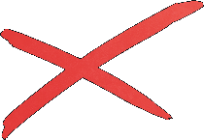
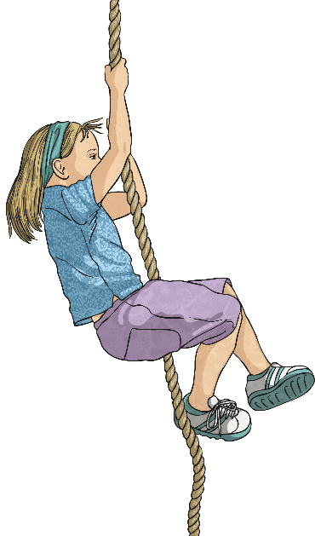
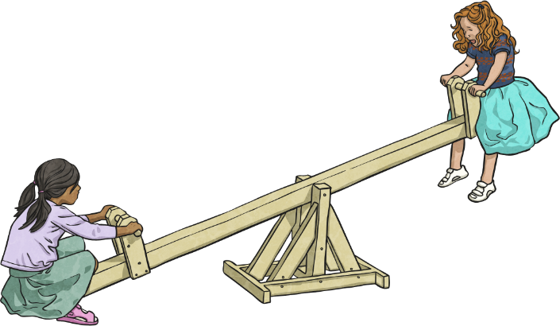
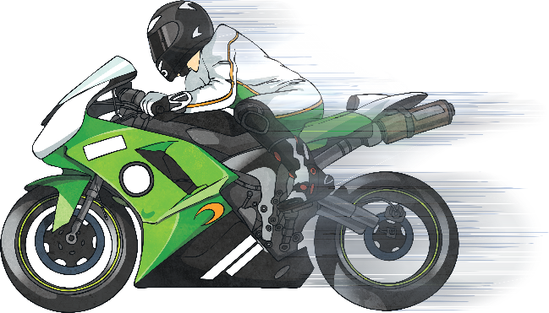
Forces
push
pull
Force is a or a
acting on an object / order.
sound
smell
grow
stop
quicker
quieter
Forces can make objects
or
or go
or
.
start
burn
quieter
slower

Slide 3
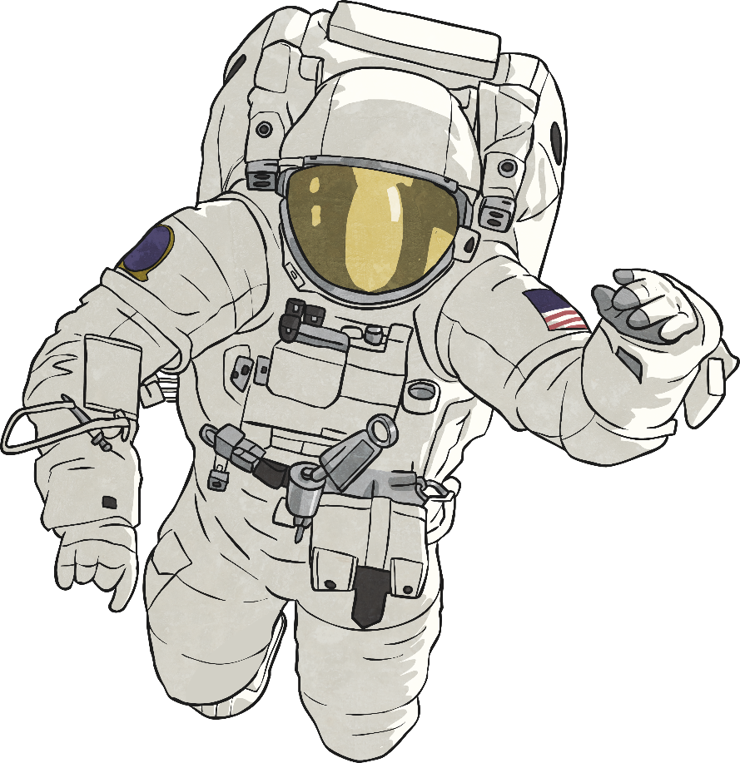
Forces
What is the name of the force that pulls things towards the centre of the Earth?
Did you answer….?
gravity
Explain why astronauts in space float around.
Did you answer….?
less gravity
‘no gravity’ would be incorrect as there is
always some gravity in space

Slide 4

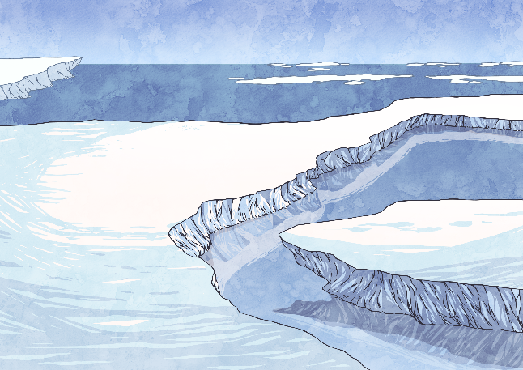
Friction
force
Friction is a that happens between two surfaces rubbing together.
weight
same
Friction always acts in the direction to the moving object,
opposite
speeds up
and always a moving object.
slows down
some
Smooth surfaces like ice create friction.
no

Slide 5
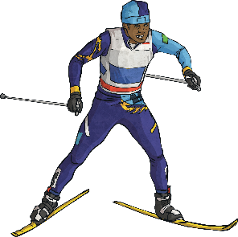
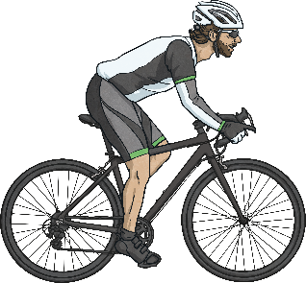

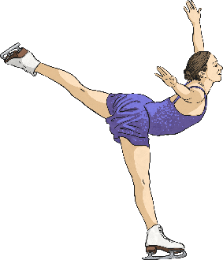
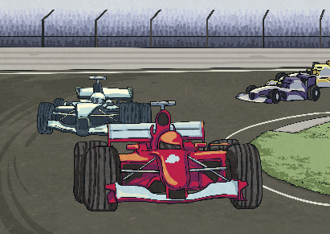
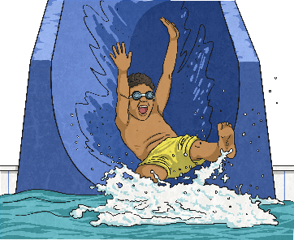
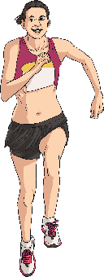
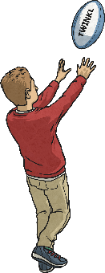
Friction
Click on all the pictures that show how friction can be a good thing.
skiing
stopping a bike
climbing a rope
ice skating
a car going round a bend
water slide
running
catching a ball

Slide 6
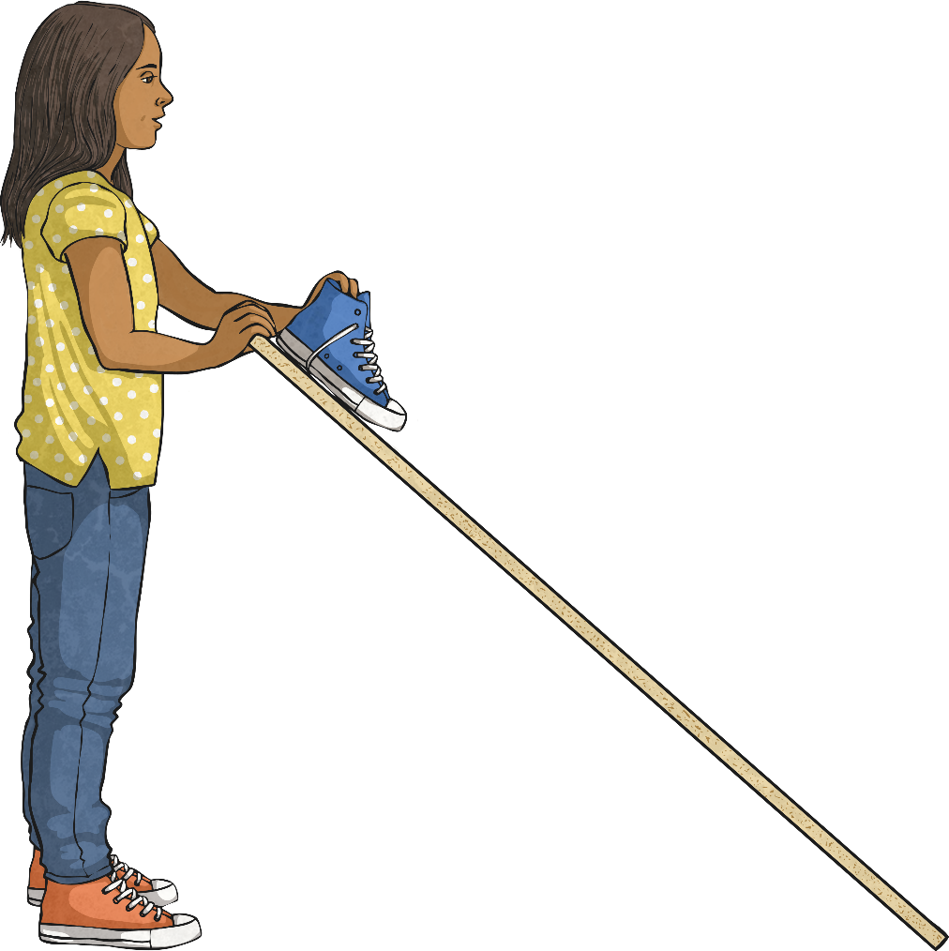
Friction
A group of Year 4 children carried out an investigation using some planks of wood with different coverings. They made each plank into a ramp and put a shoe at the top. They measured how high they had to lift the plank before the shoe slid down it. Here are the results from that investigation:
Surface on plank | Height of plank when shoe slid down
Carpet | 70cm
Rough wood | 43cm
Rubber bath mat | 82cm

Slide 7

Friction
What do these results tell you?
Surface on plank | Height of plank when shoe slid down
Carpet | 70cm
Rough wood | 43cm
Rubber bath mat | 82cm
Did you answer…?
Rubber has more grip than carpet/rough wood
Carpet has more grip than rough wood
Carpet has less grip than the rubber mat
Rough wood has less grip than carpet/ rubber mat
Rubber bath mat has the most grip
Rough wood has the least grip

Slide 8
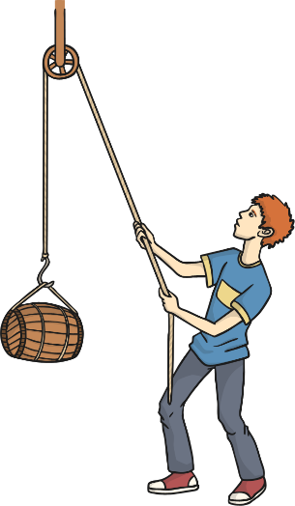
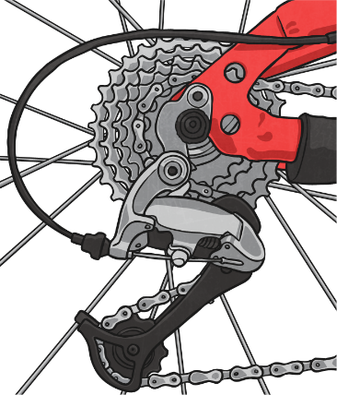
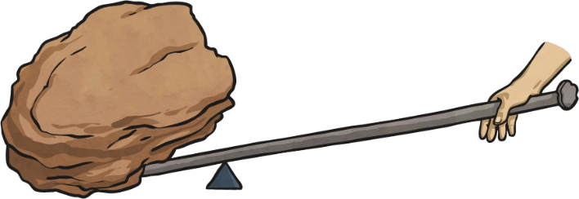
Friction
Name these three mechanisms that make things easier to do as they lessen the force needed to be used.
lever
pulley
gears

Slide 9
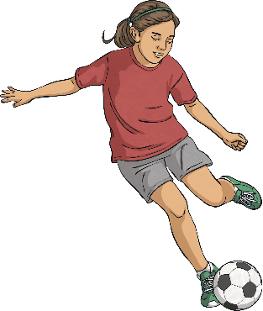
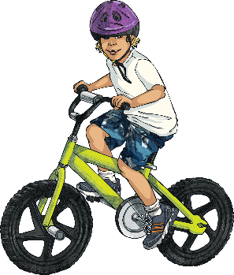
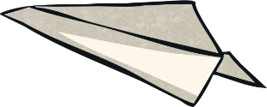
Start or Stop?
Pulling your brakes on your bike
start
stop
Kicking a ball
start
stop
A piece of toast landing on the floor
start
stop
Pedaling a bike
start
stop
Throwing a paper aeroplane
start
stop

Slide 10
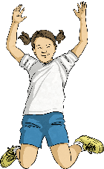

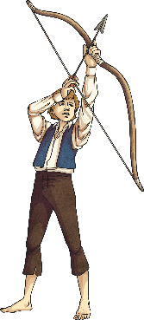
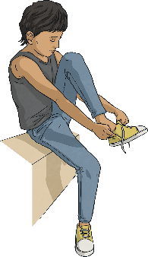
Push or Pull?
Jumping on a trampoline
pull
push
Hitting a ball with a bat
pull
push
Getting ready to fire an arrow
pull
push
A car taking a trailer somewhere
pull
push
Tying shoe laces
pull
push

Slide 11
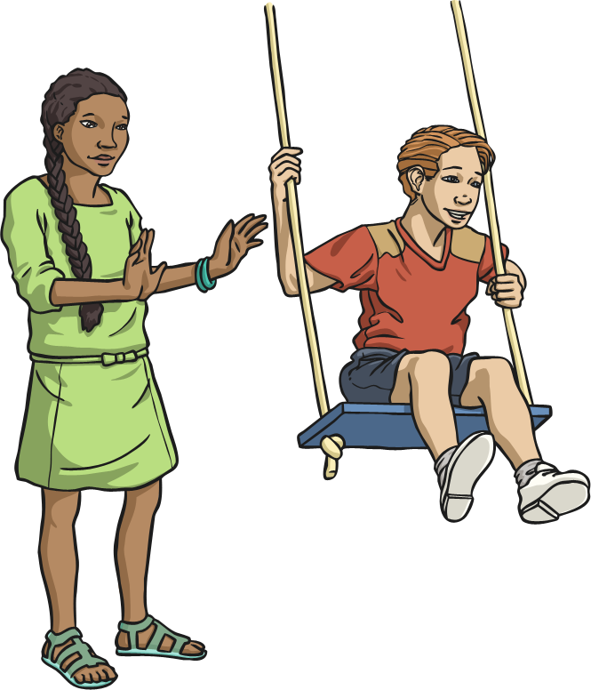
Push and Pull
Where is the pushing force coming from?

Slide 12
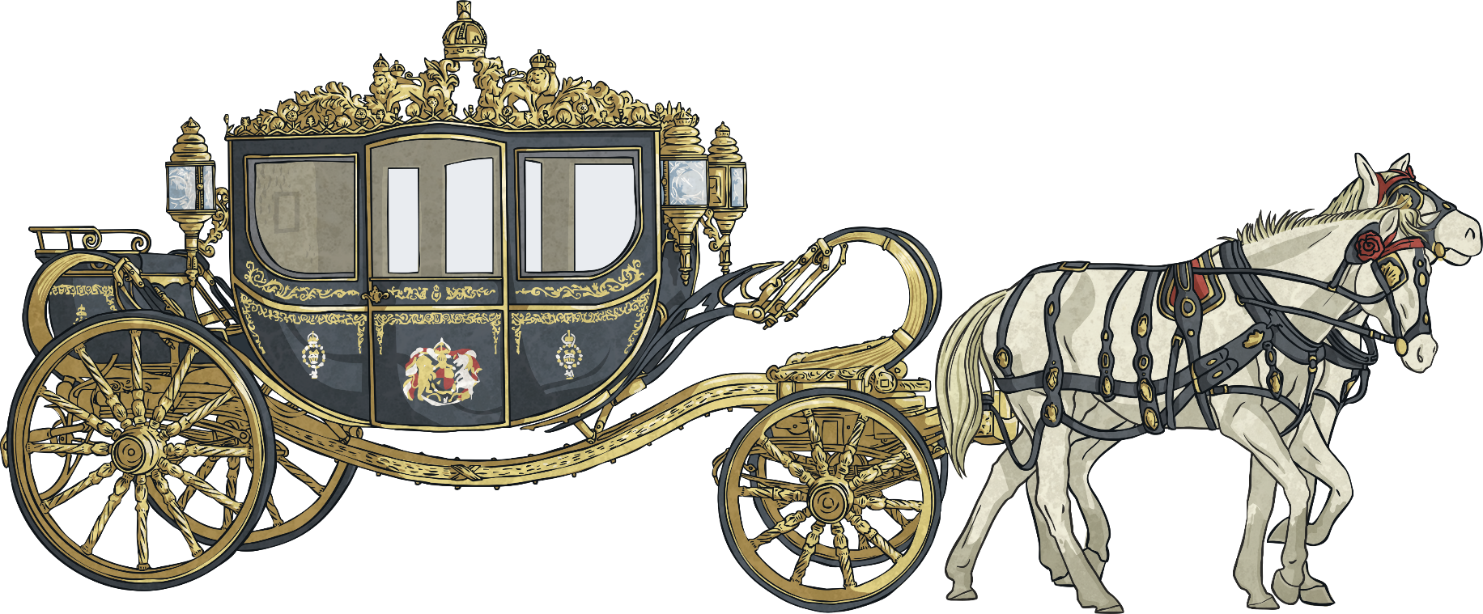
Push and Pull
Where is the pulling force coming from?

Slide 13
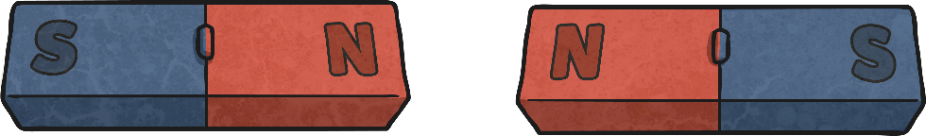
Attract or Repel
Magnets
attract
repel
attract
repel
attract
repel

Slide 14
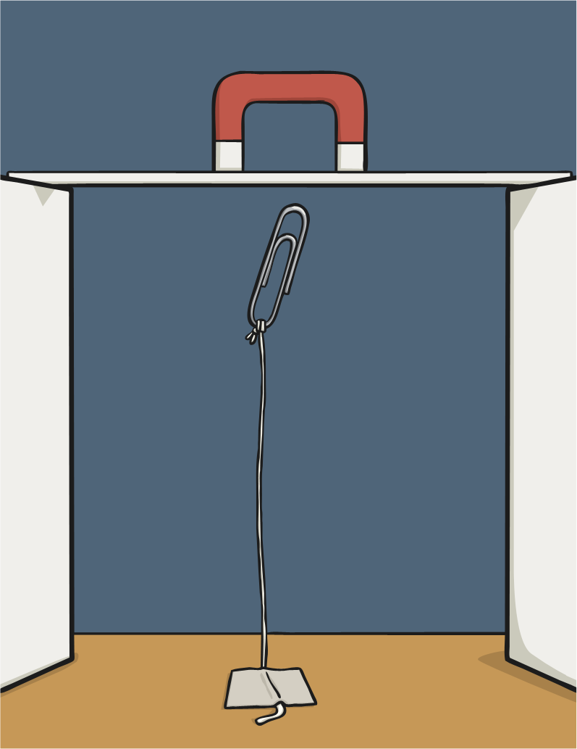
Attract or Repel
If we conducted an investigation using different magnets to see how far away they were before they picked up a paper clip, what would we find out about the magnets?
Did you answer…?
magnet strength
how strong the magnet is
the strength of the magnetism

Slide 15
Magnets
Here are the results a magnet investigation.
Magnet | Distance when attracted paperclip
medium sized horseshoe magnet | 6cm
large bar magnet | 10cm
fridge magnet | 2cm
Which is the strongest magnet?
medium sized horseshoe magnet
fridge magnet
large bar magnet
Which is the weakest magnet?
medium sized horseshoe magnet
fridge magnet
large bar magnet

Slide 16
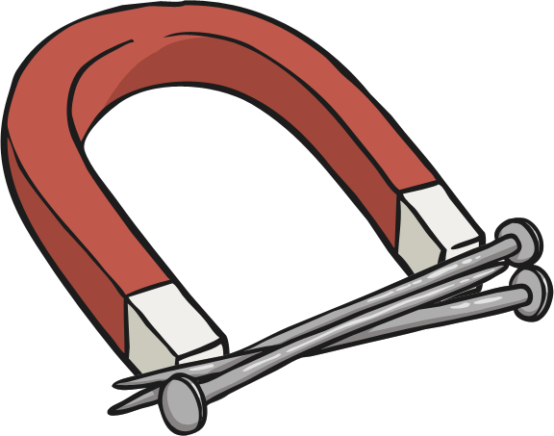
Magnets
Can you find the metals a magnet can pick up?
gold
aluminum
iron
steel
cobalt
copper
nickel
silver

