Slide 1
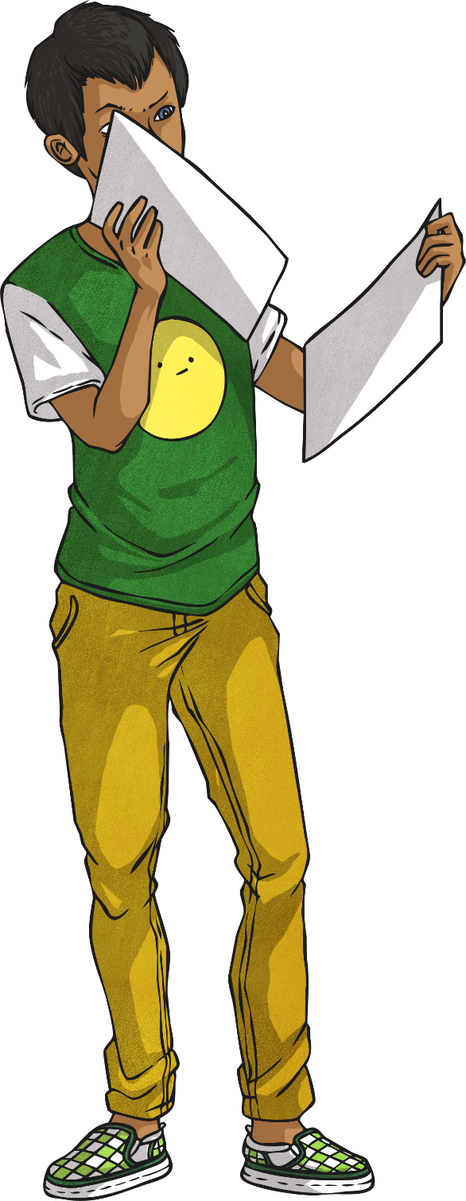
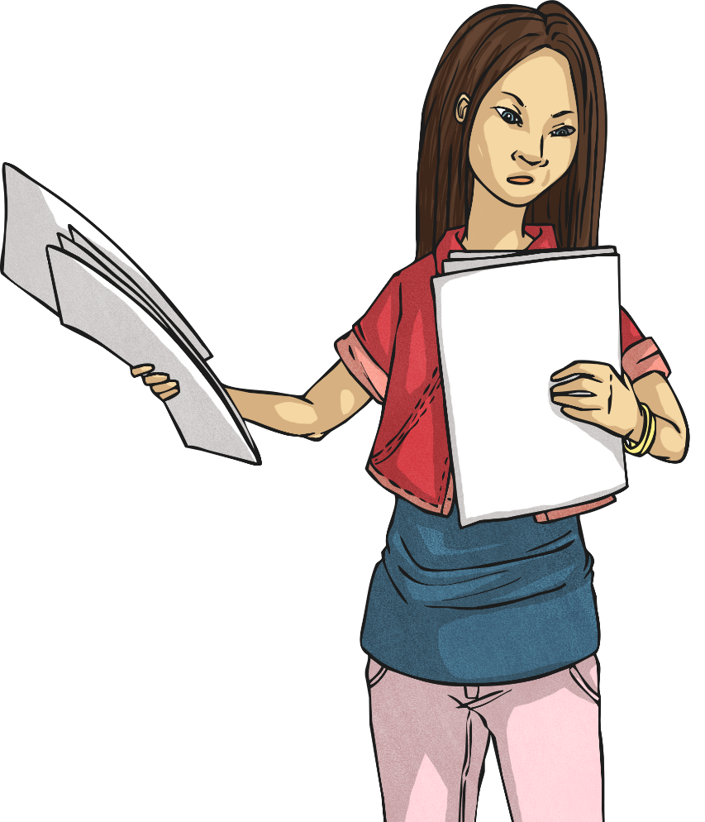
Les jours de la semaine (Days of the Week)

Slide 2




Number Fun!
quatorze !
Can you remember the numbers 0-31?
deux ?
How many days in a fortnight?
trente-et-un ?

Slide 3
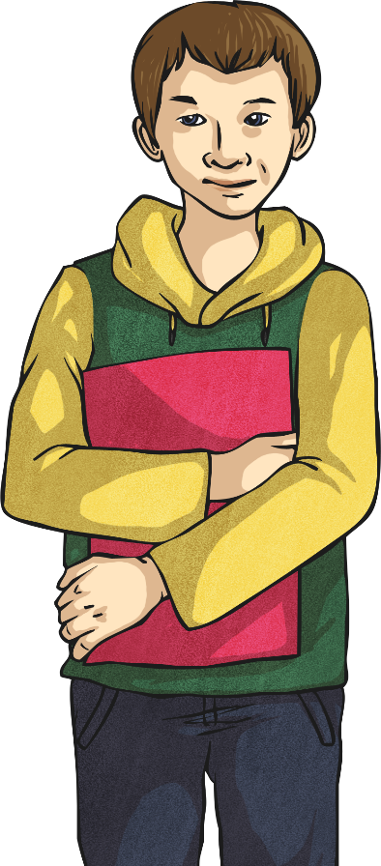
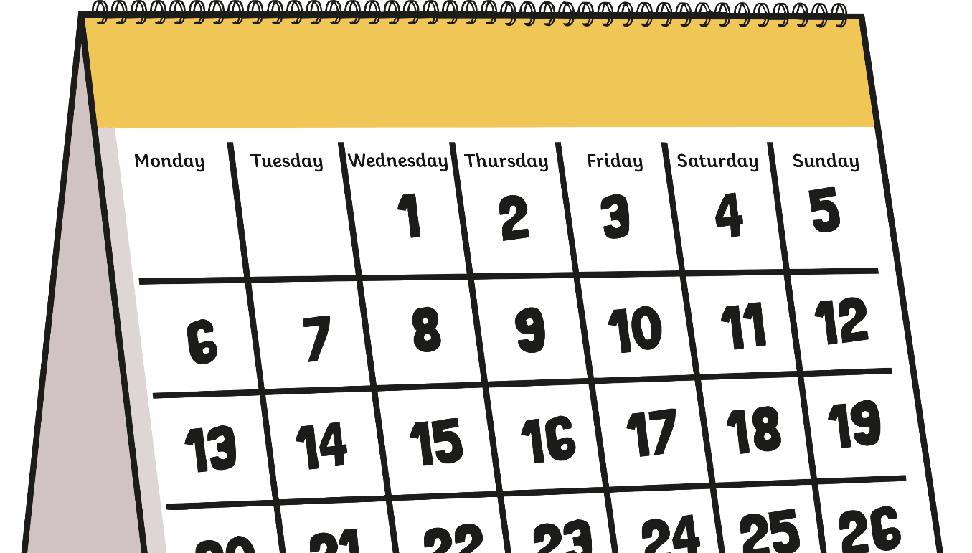
C’est quel jour ? (What Day Is It?)
C’est quel jour ?
C’est lundi.

Slide 4
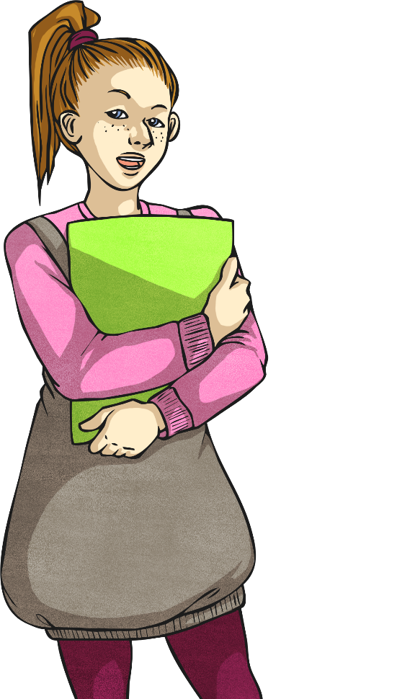
C’est quel jour ? (What Day Is It?)
C’est quel jour ?
C’est mardi.

Slide 5
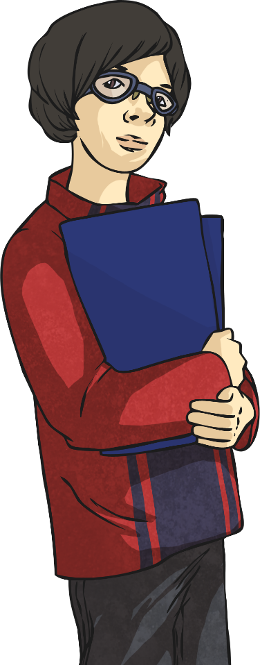
C’est quel jour ? (What Day Is It?)
C’est quel jour ?
C’est mercredi.

Slide 6
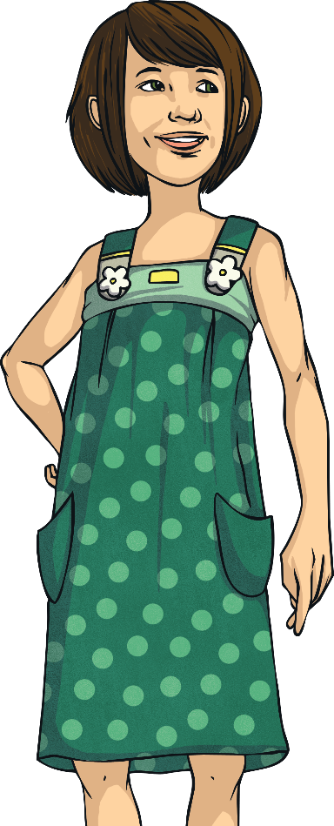
C’est quel jour ? (What Day Is It?)
C’est quel jour ?
C’est jeudi.

Slide 7
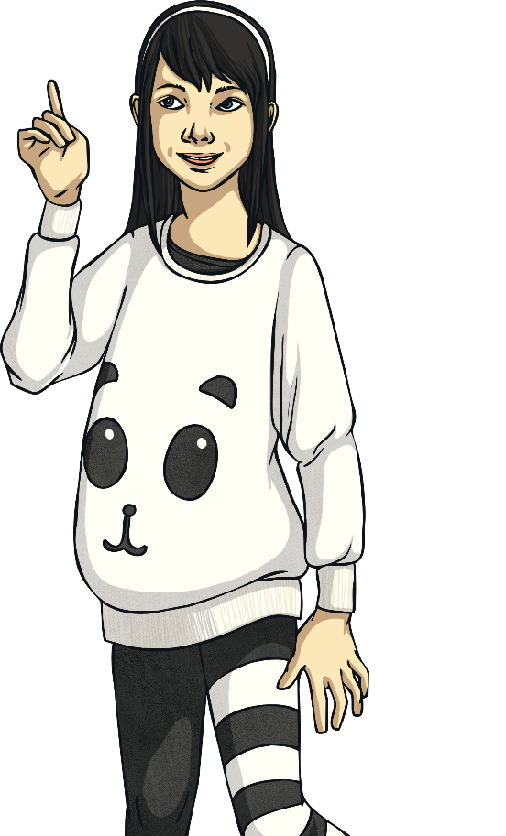
C’est quel jour ? (What Day Is It?)
C’est quel jour ?
C’est vendredi.

Slide 8
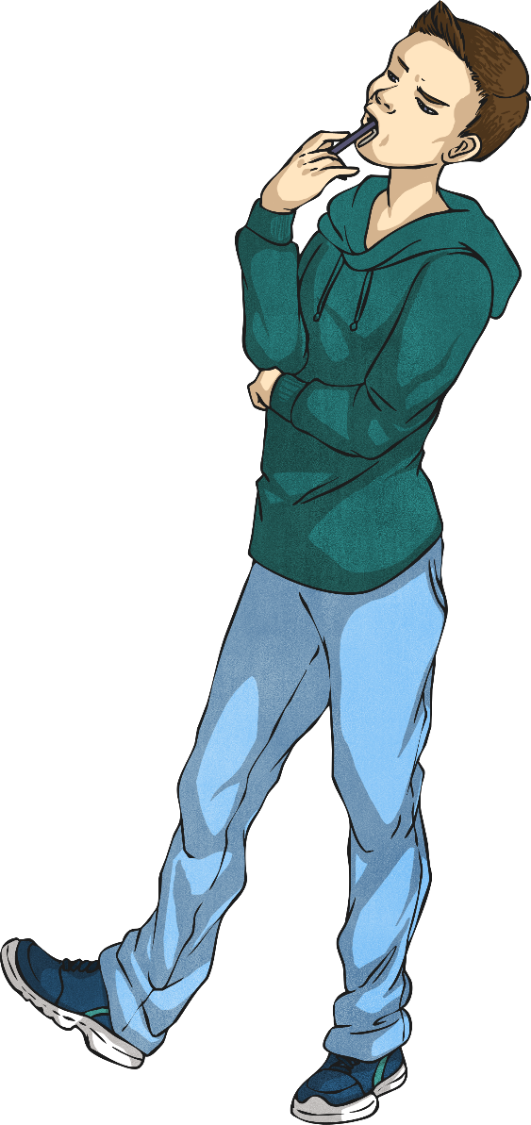
C’est quel jour ? (What Day Is It?)
C’est quel jour ?
C’est samedi.

Slide 9

C’est quel jour ? (What Day Is It?)
C’est quel jour ?
C’est dimanche.

Slide 10
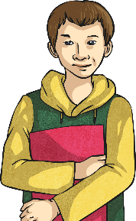






C’est quel jour ? (What Day Is It?)
lundi
mardi
mercredi
jeudi
vendredi
samedi
dimanche

Slide 11

La semaine (the week)
Qu’est-ce que c’est ?
C’est la semaine.

Slide 12
Now click the links to these games to help you practise the days of the week. You can refresh the games to play more than once if you would like to! https://www.educandy.com/site/html5/bin/main.php?activity=matchup&quizid=37920 https://www.educandy.com/site/html5/bin/main.php?activity=memory&quizid=37920 https://www.educandy.com/site/html5/bin/main.php?activity=wordsearch&quizid=37907

